Slide 1
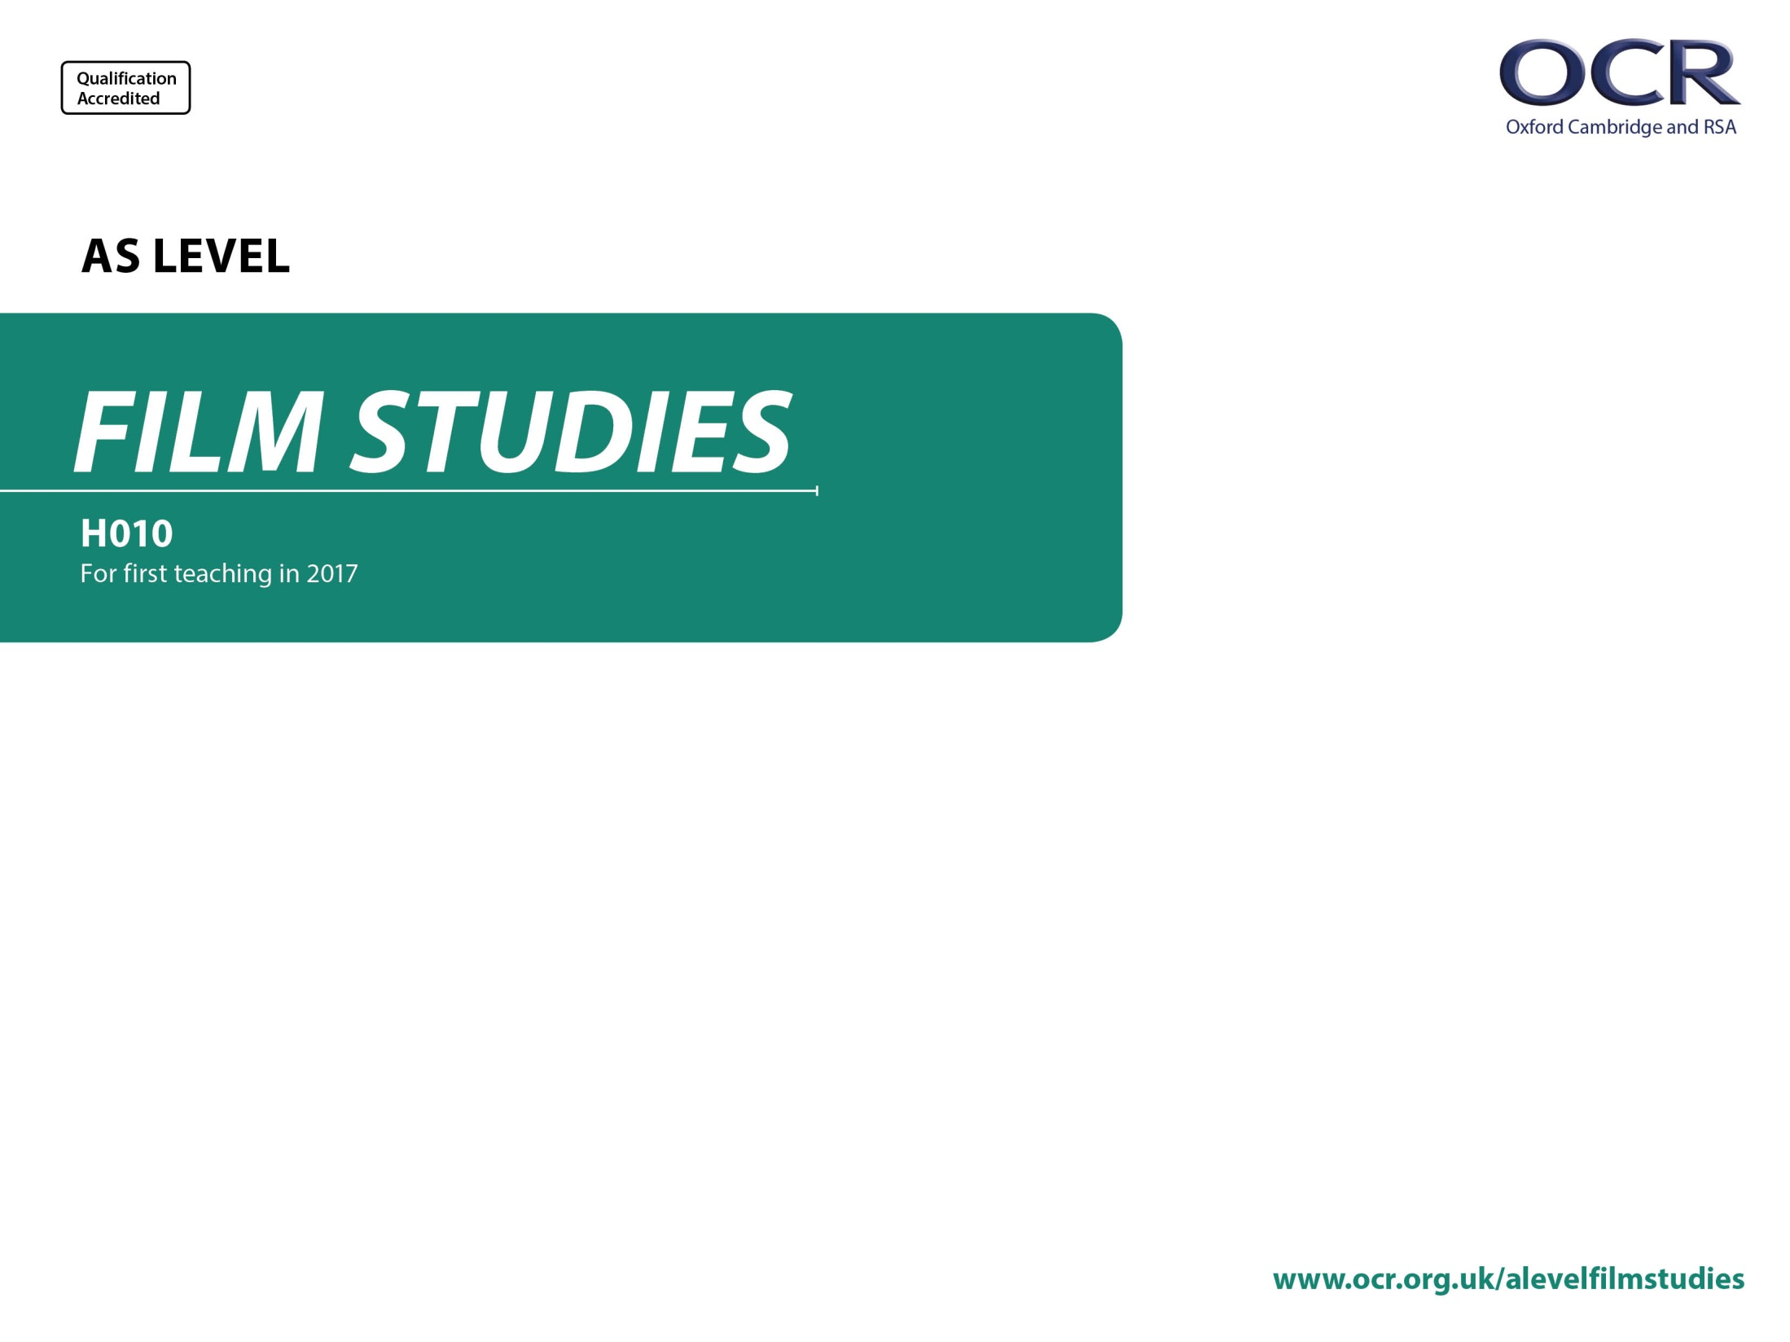
H010/01
Elements of Film
Annotated specimen assessment materials

Slide 2
Guidance
This guide is designed to take you though the AS Level Film Studies H010/01 exam paper. Its aim is to explain how candidates should approach each paper and how marks are awarded to the different questions.
The orange text boxes offer further explanation on the questions on the exam
paper. They offer guidance on the wording of questions and what candidates
should do in response to them.
The green text boxes focus on the awarding of marks for each question. They give
further information on the percentage of each assessment objective attributed
to each question. The percentage given is over the whole qualification.
This will always be a comparison of two primary sources requiring evaluation of the sources in their historical context.
AO3 (5%)

Slide 3
Assessment Objectives
AO1 - knowledge and understanding of elements of film.
AO2 - apply knowledge and understanding of elements of film to:
  1a analyse films
  1b compare films
  1c use critical approaches.

Slide 4
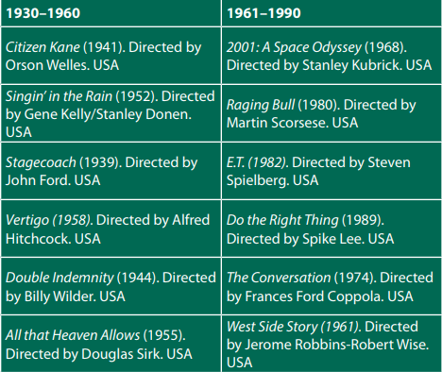
Section A: Film Form in US Cinema from 1930 to 1990
You should have studied one US film from the 1930-1960 list and one US film from the 1961-1990 list.

Slide 5
Section A: Film Form in US Cinema from 1930 to 1990
Students will always be required to answer two 5 mark questions in this section.
Answer Question 1 and Question 2.
1 With reference to a sequence from the film made between 1961–1990 which you have studied, explain how mise-en-scène can convey a film’s messages and values. [5]
2 With reference to a sequence from the film made between 1930–1960 which you have studied, explain how shot selection can convey a film’s messages and values. [5]
AO1 (3.3%) knowledge and understanding
Students should spend around 5 minutes on each of these questions.
In these questions knowledge and understanding of specific micro-elements of film form are being targeted.

Slide 6
Section A: Film Form in US Cinema from 1930 to 1990
There will always be a choice of two 25 mark questions requiring students to compare the two films they have studied.
* indicates an extended response.
Answer either Question 3 or Question 4.
EITHER
3* Compare how film aesthetics have been designed to generate spectator response in the two films you have studied. You must refer to examples in one film from the 1930-1960 list and examples in one film from the 1961-1990 list in your answer. [25]
OR
4* With reference to the two films you have studied, compare how sound and editing are used to construct meanings for the spectator. You must refer to examples from one film from 1930-1960 and examples from one film from 1961-1990 in your answer. [25]
AO1 (3.3%) knowledge and understanding
AO2.1a (6.6%) analyse
AO2.1b (6.6%) compare
Questions in this section will be in relation to micro-elements, aesthetics, spectatorship and film poetics.
Students should spend around 30 minutes on this question.

Slide 7
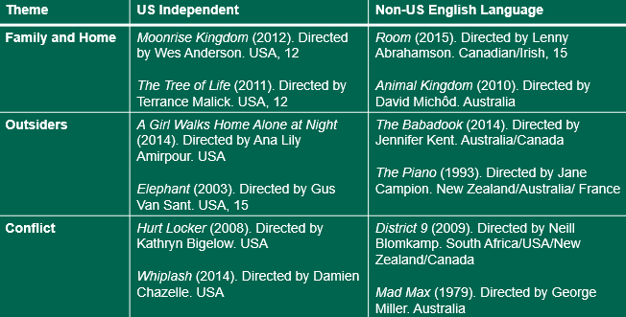
Section B: Comparative Contextual Study
Answer either Question 5 or Question 6.
You should have studied one of the themes in the table below. For your chosen theme, you should have studied one film from the US Independent list and one film from the Non-US English Language list. Questions 5-6 require you to write about the two films you have studied.
Students answer one question on their chosen theme in this section in relation to one US Independent film and one Non-US English Language film.

Slide 8
Section B: Comparative Contextual Study
There will always be a choice of two 35 mark questions requiring students to compare the two films they have studied.
Questions will focus on contexts and how meaning is created through micro-elements, genre, narrative, and representation.
Answer either Question 5 or 6.
EITHER
5* With reference to examples from the two films you have studied from your chosen theme, compare the ways in which films can reflect their social and cultural context. [35]
OR
6* With reference to examples from the two films you have studied from your chosen theme, compare how cinematography and editing contribute to narrative development. [35]
This question is focused on contexts.
* indicates an extended response.
AO1 (10%) knowledge and understanding
AO2.1a (6.6%) analyse
AO2.1b (6.6%) compare
This question is focused on micro-elements and narrative.
Students should spend around 40 minutes on this question.

Slide 9
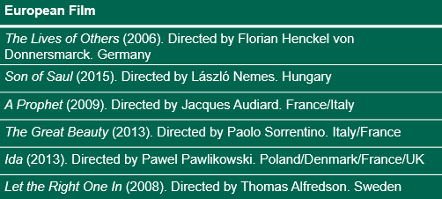
Section C: European Film: Non-English Language
You should have studied one European film from the list below. Questions 7-8 require you to write about the European film you have studied.
Students answer one question in this section in relation to the one European film they have studied.

Slide 10
Section C: European Film: Non-English Language
Students should spend around 40 minutes on this question.
There will always be a choice of two 35 mark questions.
Answer either Question 7 or Question 8.
EITHER
7* ‘A film’s narrative construction allows it to move through time and space.’ Discuss this view in relation to examples from the European film you have studied. [35]
OR
8* Discus how narrative is used to construct representations of society using examples from the European film you have studied. [35]
This question is synoptic.
Questions in this section may focus on contexts, micro-elements, meaning and response, aesthetics, genre, narrative construction and representations of cultures and societies.
* indicates an extended response.
Questions will also focus on critical debates (AO2.1c) about narrative.
AO1 (10%) knowledge and understanding
AO2.1a (6.6%) analyse
AO2.1c (6.6%) use critical approaches

