Slide 1
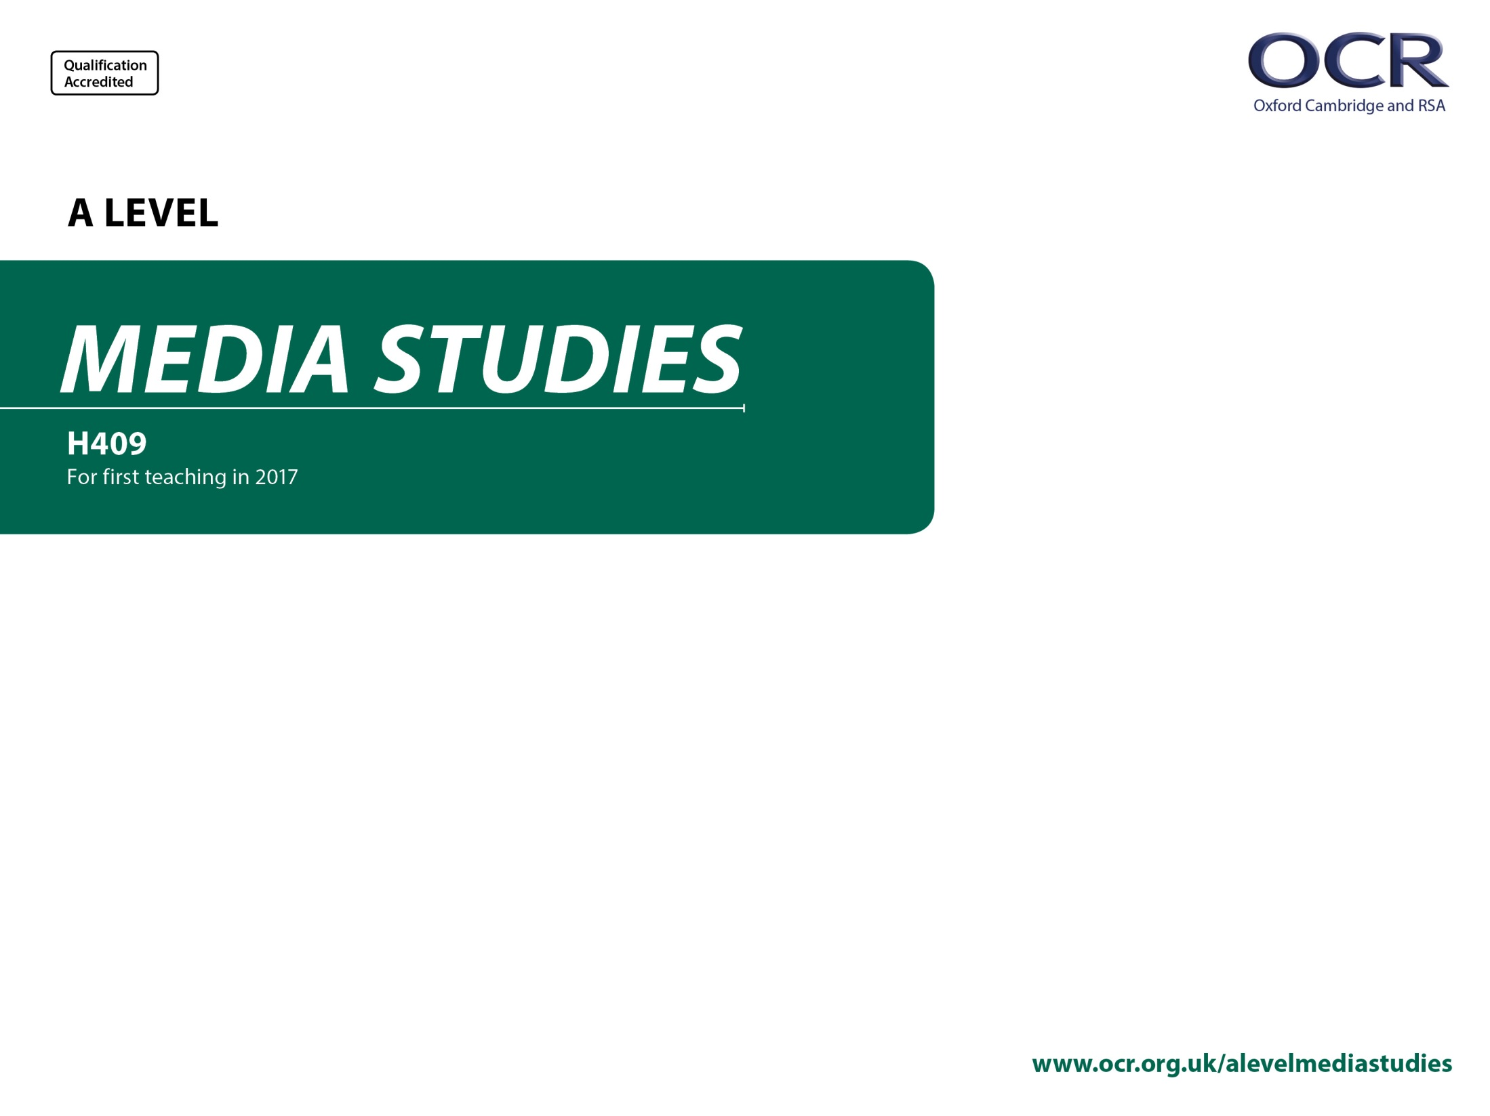
H409/01
Media Messages
Annotated specimen assessment materials

Slide 2
Guidance
This guide is designed to take you though the A Level Media H409/01 exam paper. Its aim is to explain how candidates should approach each paper and how marks are awarded to the different questions.
The orange text boxes offer further explanation on the questions on the exam
paper. They offer guidance on the wording of questions and what candidates
should do in response to them.
The green text boxes focus on the awarding of marks for each question. They give
further information on the percentage of each assessment objective attributed
to each question. The percentage given is over the whole qualification.
This will always be a comparison of two primary sources requiring evaluation of the sources in their historical context [this is an example].
AO3 (5%)

Slide 3
Assessment Objectives
AO1 - knowledge and understanding of:
  the framework
  the influence of media contexts.
AO2 - apply the framework to:
  analyse products
  evaluate theories (not AS)
  make judgements and reach conclusions.

Slide 4
Section A: News
Study Sources A and B and then answer all the questions in Section A.
News and Online:
Assessment of students’ knowledge and understanding of media language and representation will take place via UNSEEN ASSESSMENTS, which will consist of:
TWO different but equivalent examples of a ‘broadsheet’ and a tabloid (e.g. The Sun and Times as exemplified below) either print or online webpage or social and participatory feed;
…OR…
ONE example of The Mail or Guardian (print or online website or social and participatory feed) chosen from outside the period studied
PAIRED with another equivalent broadsheet or tabloid (print or online website or social and participatory feed)
In other words… The Mail and the Guardian will never appear together and sources chosen will always be unseen.
Source A – front cover of The Sun newspaper, 25 June 2016
http://www.ocr.org.uk/Images/316674-unit-h409-01-media-messages-sample-assessment-material.pdf (page 2)
Source B – front cover of The Times newspaper, 25 June 2016.
http://www.ocr.org.uk/Images/316674-unit-h409-01-media-messages-sample-assessment-material.pdf (page 3)

Slide 5
Section A: News
Students are asked to use Van Zoonen’s concept of Patriarchy – so students need to be able to understand the concept of ‘patriarchy’ and apply this to their analysis.
A direct textual analysis question directing students to ANALYSE representations in the two sources.
Analysis in this section will always be in relation to unseen sources.
1 Analyse the representations in Sources A and B. Use Van Zoonen’s concept of patriarchy in your answer. [10]
2* Sources A and B cover the same news event but are from different genres of newspaper.
How far has genre influenced the media language used in Sources A and B?
In your answer you must:
outline genre conventions in British newspapers
analyse the contrasting use of media language in the sources
make judgements and reach conclusions about how far genre has influenced the media language used. [15]
The unseen sources will always be linked by theme or event.
AO2.1 (5%)
Question 2 is focussed on genre but any element of the subject content for media language and representation could be asked about for analysis (spec pages 24-26).
* indicates an extended response question.
AO1.1 (2.5%)
AO2.1 (2.5%)
Bullet points are used to provide clarity to students for longer questions so they know exactly what detail they need to include in their answers.
As a rough guide:
10 mark questions equate to 15 minutes writing time
15 mark questions equate to 25 minutes writing time
AO2.3 (2.5%)

Slide 6
Section A: News
This question focusses on knowledge and understanding of contexts of newspaper production (AO1.2).
Context questions for news can be on social, cultural, political and economic contexts.
This section can test knowledge of theories in THREE ways:
Knowledge and understanding of theory (AO1.1)
Analysis and/or judgements using theory (AO2.1 and AO2.3)
Evaluation of theory (AO2.3)
Where theory is a specific requirement it will be clear in the question e.g. Q1, Q4.
Explain how the political context in which newspapers are produced, influences their ownership and regulation. Refer to The Guardian and The Daily Mail newspapers you have studied to support your answer. [10]
Evaluate the usefulness of one of the following in understanding audiences for online newspapers such as The Guardian and The Daily Mail:
EITHER
Gerbner’s cultivation theory
OR
Shirky’s ‘end of audience’ theory. [10]
This question will always focus on the ‘evaluation’ of theory in relation to print or online news (AO2.2).
Note, this is not an analysis question.
Students should evaluate the usefulness of the stated theory in relation to the question using exemplification from the named set product(s) for online or print news.
Remember 10 marks equates to around 15 minutes writing time.
AO1.2 (5%)
AO2.2 (5%)

Slide 7
Section B: Media Language and Representations
In this section there are two questions.
Only TWO out of the three media forms in this section will be assessed each series.
In the specimen paper music videos and magazines are assessed.
There will be NO theory questions in this section.
This is a knowledge and understanding question on music videos (AO1).
There is no command word to ‘analyse.’
Questions can be focussed upon the non-theory content of the media language and representation subject content (spec pages 24-26)
For example, this question is targeting subject content point 6 on page 26 of the spec.
“the impact of industry contexts on the choices media producers make about how to represent events, issues, individuals and social groups “
5 Explain how representations in music videos are chosen to promote the artist(s). Refer to one of the music videos you have studied to support your answer. [10]
You should have studied two music videos: one from List A and one from List B below.
List A | List B
Corinne Bailey Rae – Stop Where You Are | Radiohead – Burn the Witch
Massive Attack – Unfinished Sympathy | Fatboy Slim – Ya Mama
Emeli Sandé – Heaven | David Guetta – Titanium
AO1.1 (5%)
When music videos are assessed unseen sources will never be used. Students will be expected to use recall from their classroom learning.
Music video questions could ask about one or two of the set videos.

Slide 8
Section B: Media Language and Representations
Source C – front cover of The Big Issue, 13 June 2016
http://www.ocr.org.uk/Images/316674-unit-h409-01-media-messages-sample-assessment-material.pdf
(page 6)
Source C shows four politicians’ heads on the bodies of the members of the group Abba. The words are taken from famous Abba songs. The issue was published before the British referendum on remaining in or leaving the European Union. From left to right, the politicians are: Nicola Sturgeon, Scotland’s First Minister, David Cameron, Britain’s Prime Minister, Boris Johnson and Nigel Farage, both prominent Leave campaigners.
Analysis questions for magazines and advertising and marketing will use unseen sources (in this case a cover picked from before the period of study).
All three media forms assessable in this section can be tested via AO1 (knowledge and understanding) or AO2 (analysis)
Students aren’t being tested on their knowledge of political leaders or 70’s pop groups.
When this kind of cover is chosen a caption will describe to students relevant information as exemplified in the specimen paper.

Slide 9
Section B: Media Language and Representations
A direct textual analysis question directing students to ANALYSE the use of intertextuality to create meaning in the source.
Analysis of magazines will always be in relation to an unseen cover.
Analyse why The Big Issue magazine has used an intertextual approach to the referendum on its front cover.
In your answer you must:
Analyse the use of intertextuality to create meaning in the source
make judgements and reach a conclusion about the advantages of this use of intertextuality to The Big Issue magazine. [15]
This question focusses on media language (intertextuality) but could focus on any of the subject content for media language and representation (spec pages 24-26).
AO2.1 (5%)
AO2.3 (2.5%)
Bullet points are used to provide clarity to students for longer questions so they know exactly what detail they need to include in their answers.

