Slide 1

Geography A
H070 Topic Title
H470 Topic Title

Slide 2
Guide to the SAMs
Component 3 –
Geographical Skills

Slide 3
J383/03 Geographical Skills
Within the study of GCSE (9-1) Geography A (Geographical Skills) learners get the opportunity to select, adapt and use geographical skills throughout their study of the content of Living in the UK today (01) and The World Around Us (02).
This assessment has a large focus on geographical skills and will be contextualised in the geographical content of the other two components. There will also be synoptic assessment of content from components 01 and 02.
But what will the assessments look like?
This guide will give you an understanding of the format and structure of the exam, an insight into the assessment objectives and a question by question explanation of the sample assessment for J383/03 Geographical Themes. This guide can also be used with your students to support revision.

Slide 4
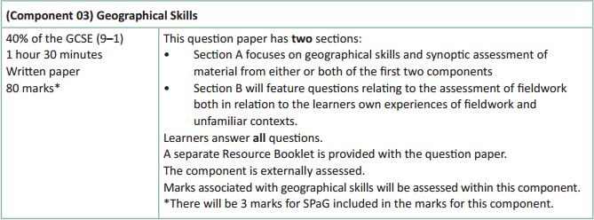
How will Geographical Skills be assessed?
No optionality – students know what they need to do and will not get confused as to which option they should answer.
34 marks for AO4 (skills)
A separate Resource Booklet so students can access resources easily when answering questions.
3 marks for SPaG will be on the 8 mark fieldwork question.

Slide 5
How will Living in the UK today be assessed?
The exam will be 80 marks (3 of which are for SPaG) and there is 1 hour 30 minutes to complete the exam (more than a minute per mark). There is more time available for this exam due to the requirement for students to interact with more resources.
The Assessment Objective breakdown for the overall paper is:
There are two sections within this component – Section A (Geographical Skills) and Section B (Geographical Fieldwork). As can be seen in the table above, there are no marks for AO1 (knowledge) within this assessment. As there are no AO1 (knowledge) marks this means that case study knowledge will not be required within this assessment.
But let’s have a look at the assessment in more detail on the following slides.
 | AO1 (Knowledge) | AO2 (Understanding) | AO3 (Application) | AO4 (Skills) | SPaG | Total
Marks | 0 | 6 | 37 | 34 | 3 | 80

Slide 6
Geographical Skills - Section A
Questions in Section A of the assessment could be contextualised through any part of the specification – but there will be a narrative to the questions. In this sample assessment material the section is contextualised through urban and energy issues within Bradford and then Lagos.
There will be a mixture of short answer, point marked questions (1, 2, 3 and 4 mark questions) with 6 mark and 8 mark level of response questions included as well. The level of response questions will be where synopticity is assessed.
For Section A there will be questions on AO2, AO3 and AO4 with the following totals across Section A:
 | AO1 (Knowledge) | AO2 (Understanding) | AO3 (Application) | AO4 (Skills) | Total
Marks | 0 | 6 | 17 | 24 | 47

Slide 7
Geographical Skills - Section B
Fieldwork is assessed in section B and there will be 33 marks in this section – which includes 3 SPaG marks.
There will be a mixture of short answer, point marked questions (1, 2, 3 and 4 mark questions) with 6 mark and 8 mark level of response questions included as well.
The 8 mark question will also have 3 SPaG marks available (total of 11 marks for question).
In Section B there will be assessment of physical and human geography fieldwork – with questions being either in relation to the students’ own experiences of fieldwork or unfamiliar contexts (resources) which students will first encounter in the exam.
Section B will include questions with marks targeting AO3 (application) and AO4 (skills). There will be 20 marks for AO3 and 10 marks for AO4 in this section.

Slide 8
Other things to know about the assessment…
There are a few other important things to highlight for the assessment and to help you understand the mark scheme, so now we will run through:
    SPaG
    Quality of Extended Responses
    Marking Guidance

Slide 9
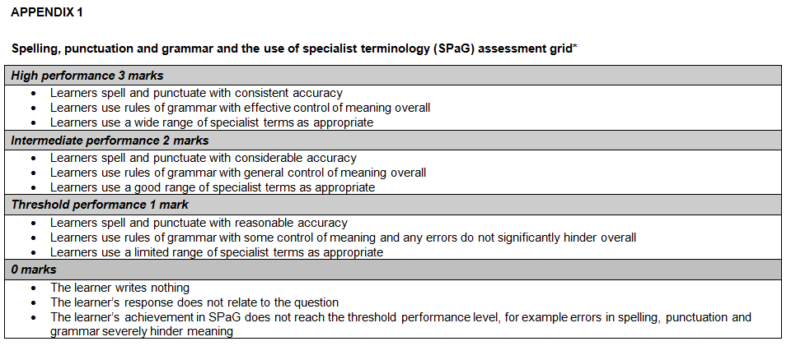
SPaG
SPaG – also known as spelling, punctuation and grammar and the use of specialist terminology – is assessed against one of the longer questions in the exam with 3 marks available. In the ‘Geographical Themes’ assessment, SPaG will always be assessed on the 8 mark fieldwork question.
There are clear descriptors for each level of SPaG, which are separate from the geographical content of the rest of the question. The student’s answer is read holistically and the SPaG marks are awarded on the whole answer.

Slide 10
Quality of Extended Responses
‘Quality of extended response’ is assessed within each level for questions of 8 marks or above and is indicated by an asterisk (*) beside the question. The following are the descriptors placed within the levels for 8 mark questions:
Level 3
There is a well-developed line of reasoning which is clear and logically structured. The information presented is relevant and substantiated.
Level 2
There is a line of reasoning presented with some structure. The information presented is in the most-part relevant and supported by some evidence.
Level 1
The information is basic and communicated in an unstructured way. The information is supported by limited evidence and the relationship to the evidence may not be clear.
The way that a student has structured their response would need to be considered when you are deciding which level to place the student in – but the quality of the geographical content within the answer should always be the most important consideration.

Slide 11
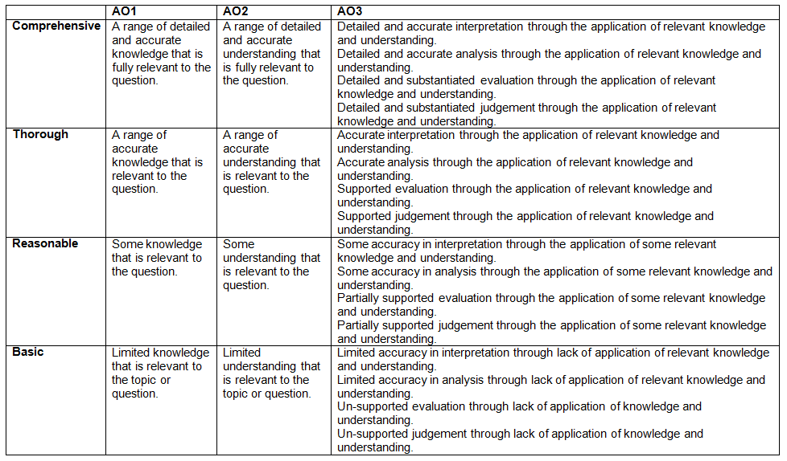
Level of Response Questions Marking Guidance
At the beginning of each mark scheme the following table is included to help you understand the level of response questions mark schemes. The wording in each level (from basic to comprehensive) indicates how answers develop and progress within each assessment objective.

Slide 12
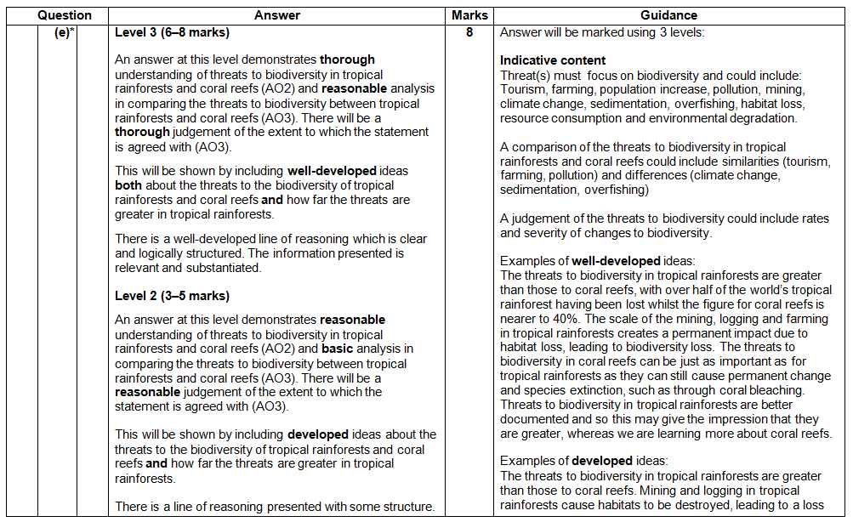
Level of Response Question Mark Scheme
The ‘Answer’ column includes information on how the assessment objectives link to the question and the standard required for the question parts.
The ‘Indicative content’ part of the mark scheme shows some of the content which could be included in students answers. This is not an exhaustive list.
A statement to indicate the level of development for answers to reach each level.
In the ‘Guidance’ column there are examples of ‘well-developed’, ‘developed’ and ‘simple’ ideas – these are examples of parts of answers – they are not full answers. The examples should show how an answer can develop from ‘simple’ to ‘developed’ to ‘well-developed’.
If ‘Quality of Extended Responses’ and/or ‘place-specific detail’ are being assessed they will be shown here

Slide 13
Assessment Objectives
The assessment objectives are set by Ofqual and are vital to exam boards when designing assessments and for teachers in understanding styles of questions and their requirements.
For GCSE (9-1) Geography there are 4 Assessment Objectives :
      AO1 (Knowledge)
      AO2 (Understanding)
      AO3 (Application of knowledge and understanding)
      AO4 (Skills).
For all of the GCSE Geography specifications there are set assessment objectives with exact percentages of marks which must be attributed to each assessment objective within the qualification throughout the lifetime of the specification.
The next few slides will explain what the four assessment objectives mean and clarify their use in this assessment.

Slide 14
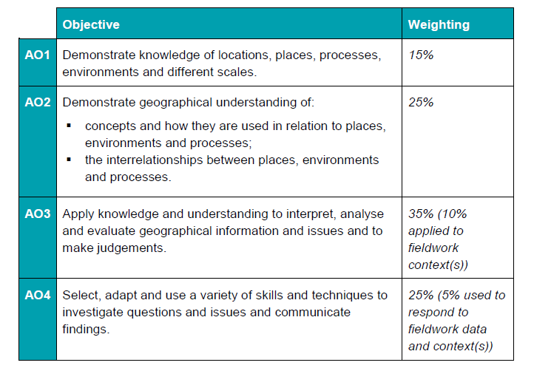
The 4 Assessment Objectives (AOs)
15% of the qualification
marks will be allocated to assessing students knowledge of the specification content (AO1)
25% of the qualification marks will be allocated to assessing students understanding of the specification content (AO2)
35% of the qualification
marks will be allocated to assessing students application of their knowledge and understanding of the specification content (AO3)
25% of the qualification
marks will be allocated to assessing students ability to select, adapt and use geographical skills and communicate findings in this context (AO4)

Slide 15
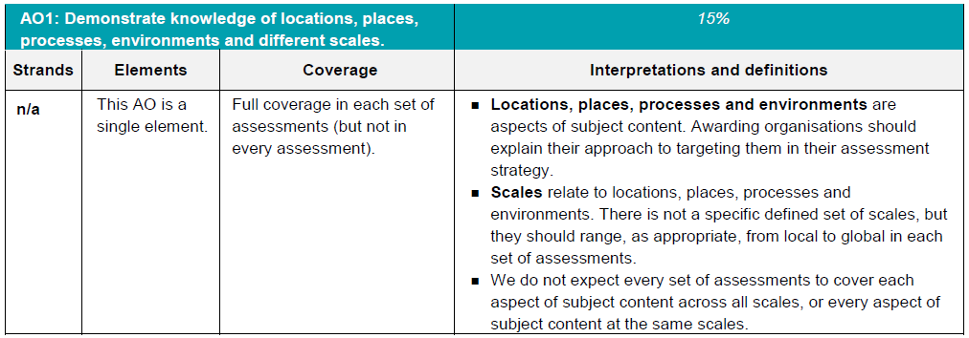
AO1 - Knowledge
Locations, places, processes and environments simply cover the subject content. There are other ways which you may describe content areas but all must be placed in these four aspects when we are creating our assessments.
Each year across the range of assessments there must be knowledge marks for locations, places, processes, environments and different scales but AO1 marks do not have to be included in every assessment.
Each year assessments will cover different scales
from local to global but not for every bit of content
or necessarily for all of locations, places, processes
and environments .

Slide 16
AO1 command words
AO1 requires candidates to demonstrate knowledge of the specification content through recalling information – including in a case study context.
Questions which target AO1 alone would tend to be shorter answer questions but longer questions may have AO1 marks allocated to them as well when combined with another assessment objective – particularly where case study information is required in an answer.
The following are some of the command words which may be used for short answer questions with AO1 marks:
  Describe
  Define
  Outline
  State
All of these command words are asking students to write down something that they have learnt from the specification and so are unlikely to be targeting a combination of assessment objectives.

Slide 17
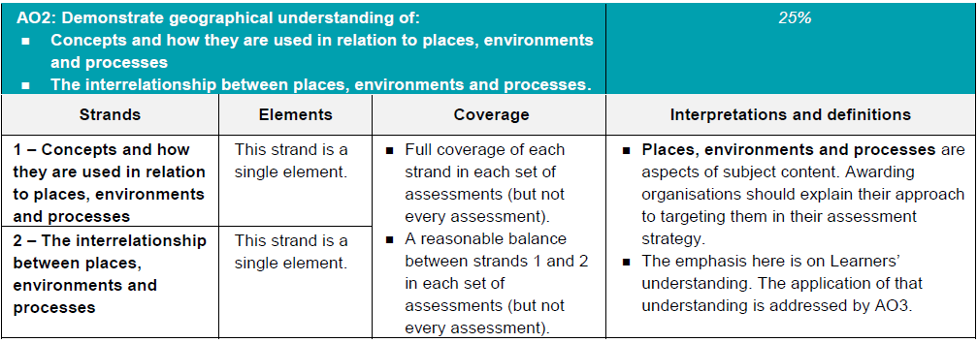
AO2 - Understanding
How concepts relate to the aspects of content.
Like with AO1 – places, processes and environments simply cover the subject content.
There must an appropriate balance in terms of the number of marks allocated to questions on the understanding of how concepts relate to content and how aspects of content relate to each other throughout the assessments.
How aspects of content relate to each other

Slide 18
AO2 command words
Questions with AO2 marks will focus on:
how concepts relate to the aspects of content
how aspects of content relate to each other
All AO2 marks will focus on understanding. AO2 marks will be directly linked to the specification but not just recalling what has been learnt, instead ensuring that students comprehend the content.
The following are some of the command words which may be used for questions with AO2 marks:
Explain how
Explain reasons/one reason
Discuss
AO2 marks may also be targeted in higher mark tariff questions but the command word may focus on a different assessment objective (e.g. AO3).
These command words may be used to solely target AO2 but may also be used in combination with other AO’s to target multiple assessment objectives, for example questions 1(d) or 2(b) of component 01 Living in the UK today.

Slide 19
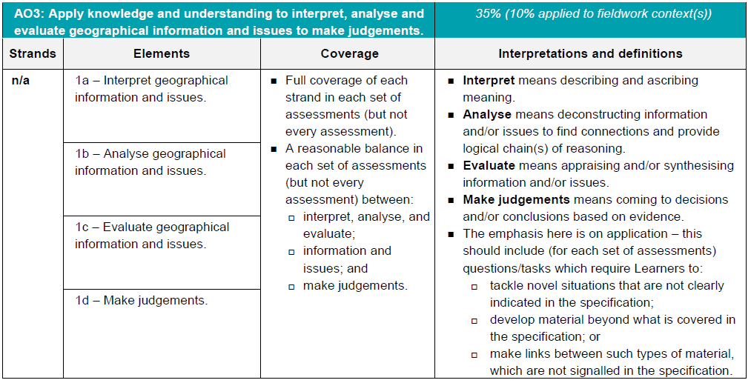
AO3 - Application
10% of the marks for the qualification must be allocated to the application of knowledge and understanding in a fieldwork context.
Three ways that students will need to apply their knowledge and understanding:
‘tackle novel situations’ could mean applying knowledge and understanding to a resource
‘developing material beyond the specification’ could be evaluating the success of a management strategy when the specification doesn’t explicitly ask for that
‘making links between such types of material which are not signalled in the specification’ could be synoptic questions.

Slide 20
AO3 command words
Command words will vary depending on whether students are applying their knowledge and understanding by interacting with a resource(s) or not.
The following are some of the command words which may be used for questions with AO3 marks:
Weigh up whether a statement is true.
Interacting with resource | No resource
Describe | Assess
Give | Examine
Suggest | Evaluate
Outline | To what extent do you agree
Look in close detail and establish the key facts and important issues.
Give your verdict after providing evidence which both agrees with and contradicts an argument.
How much you agree with a statement based on the evidence in the argument.

Slide 21
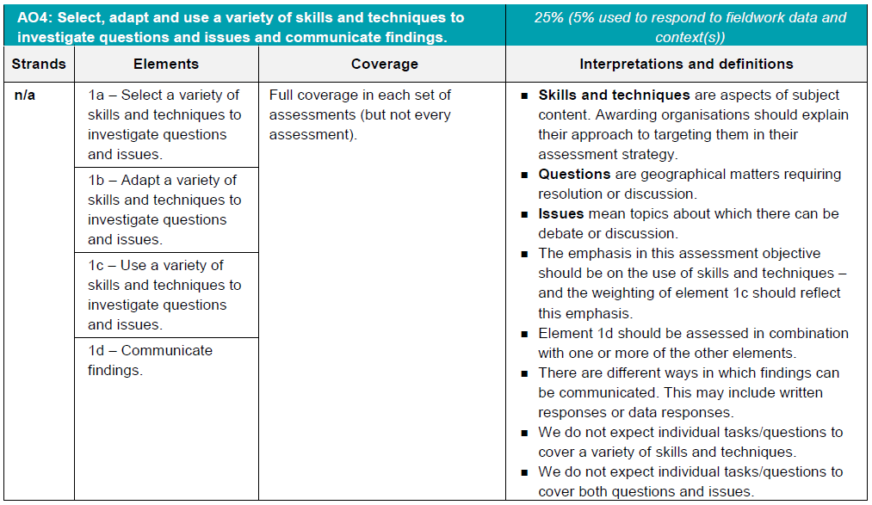
AO4 - Skills
5% of the marks for the qualification must be allocated to geographical skills in a fieldwork context.
Most of the AO4 marks will be allocated to using geographical skills – however there must be marks targeting ‘questions’ and ‘issues’ for selecting skills, adapting skills and using skills, as well as marks targeting ‘communicating findings’.

Slide 22
AO4 command words
AO4 requires students to select, adapt and use geographical skills, as well as communicate findings.
The following are some of the command words which may be used for questions with AO4 marks:
  Describe the pattern
  Using data
  Calculate
  Identify
  Make a prediction
Commands words may vary depending on the level of interaction with a resource.

Slide 23
Question 1(a)(i) – 1 mark
Study Fig. 1 in the separate Resource Booklet, an OS map extract of Bradford.
In which general direction would you be travelling if you were approaching Bradford from the junction of the M62/M606 motorways?
A East
B North West
C South
D South East
This question assess’ students map reading skills in the context of an OS map – an AO4 (skills) question.
Students need to find the junction of the M62/M606 motorways and work out which direction Bradford is from this point. The answer is ‘B: North West’.
The map has a north arrow for reference and to allow access to the question.

Slide 24
Question 1(a)(ii) – 1 mark
What is the approximate length of the M606 motorway from its junction with the M62 (182 268), to its junction with the A6177 (166 303)?
A 4 km
B 5 km
C 8 km
D 12 km
This is an AO4 (skills) question where students need to use their skill of using and understanding coordinates, scale and distance in terms of an OS map.
Students need to choose which of the four choices is the approximate length of the M606 motorway from its junction with the M62 (182 268) to its junction with the A6177 (166 303). The answer is ‘A: 4 km’.
The map has a scale bar for reference and to allow access to the question.

Slide 25
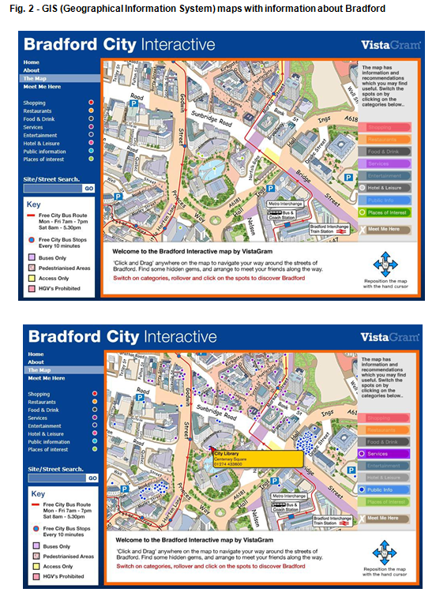
Question 1(b)(i) – 1 mark
Geographical Information Systems (GIS) can provide useful information about the geography of an area. Study Fig. 2 in the separate Resource Booklet, GIS maps with information about Bradford.
Using Fig. 2 identify one piece of evidence that this area contains Bradford’s city centre.
This is an AO4 (skills) question where students use their cartographic skill of being able to describe, interpret and analyse geospatial data presented in a GIS framework.
Evidence identified must be evident in Fig. 2 not just taken from the OS Map in Fig. 1.
For example, evidence could include:
  location of bus and coach station (✓)
  train station (✓)
  city library (✓)
  high building density (✓).

Slide 26
Question 1(b)(ii) – 2 marks
Explain why a GIS map, such as the one in Fig. 2, might be more useful for a visitor to Bradford than the OS map extract, such as the one in Fig. 1.
This question is an AO4 (skills) question targeting students ability to ‘suggest …reasons for using maps’.
Students need to explain why a GIS map might be more useful than an OS map for a visitor to Bradford. There are 2 marks so two points should be made. Any appropriate answer should be credited and some examples include:
GIS maps can contain more specific and detailed information than OS maps (✓)
You can add information to a GIS map about shopping/restaurants/services when required which you cannot do with an OS map (✓)
You can remove information that is not required with a GIS map which you cannot do with an OS map (✓)

Slide 27
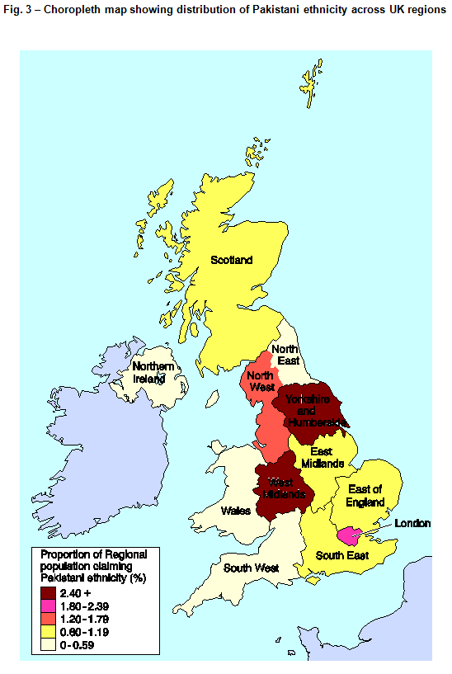
Question 1(c) – 2 marks
Study Fig. 3 in the separate Resource Booklet, a choropleth map showing distribution of Pakistani ethnicity across UK regions.
Suggest two reasons why the information represented on this map might be misleading.
This is an AO4 (skills) question targeting students ability to ‘suggest improvements to, issues with or reasons for using maps, graphs, statistical techniques and visual sources, such as photographs and diagrams’.
Students must suggest issues with the map which may make it misleading.
For example, reasons could include:
  Differences within regions, can be hidden by the shading (✓)
  Map does not distinguish between urban and rural areas (✓)
  May suggest some areas have a high/low percentage, which actually do not (✓)
  Gives false impression of abrupt changes at the boundaries (✓).

Slide 28
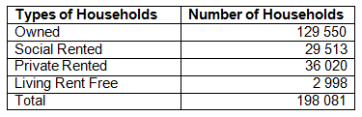
Question 1(d) – 4 marks
Study the table below, which shows types of households in Bradford and the number of households in each category.
Describe the pattern of the types of households in Bradford. Use data from the table in your answer.
This is a 4 mark AO4 (skills) ‘describing the pattern’ question, so there will be a mark for the order that the answer is written (communicating findings). There is also the command to use data from the resource – therefore there is a mark for picking out data.
That leaves 2 marks for describing the pattern. So students need to make two points to describe the data, use data for one of the points and put the two points in the most logical order.
Make sure students take a couple of seconds to think about their two points before putting pen to paper, it might help them get the communicate findings mark!

Slide 29
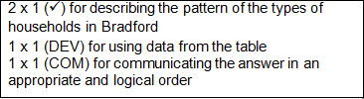
Question 1(d) – 4 marks
In the mark scheme example, the two marks for describing the pattern are indicated with a tick (✓).
The data mark is shown with a (DEV) – it is specific information picked out from the resource – in this instance for using data from the table.
The mark for communicating the answer in an appropriate and logical order (COM) is shown last – but that is because that is just where the answer finishes. The mark is specifically awarded because the general pattern is given first and then a specific point about the pattern is made afterwards.

Slide 30
Question 1(d) – The mark scheme
General pattern
Data from resource
The vast majority of households in Bradford are owned (✓), with almost two-thirds (129 550 out of 198 081) of households being owned (DEV). The share of private rented households compared to socially rented households is fairly equal with a very small number categorised as living rent free (✓) (COM)
Specific part of pattern
Overall answer looked at – mark awarded as the general pattern is given first and then a specific point about the pattern is made afterwards.

Slide 31
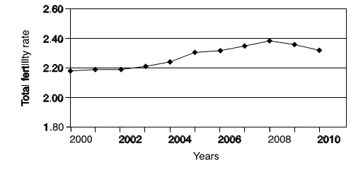
Question 2(a) – 3 marks
  Study the graph below, which shows how the total fertility rate in Bradford changed between 2000 and 2010.
  Describe the trends in the total fertility rate over the period shown.
This is an AO4 (skills) question as students need to use their skill of interpreting graphs to be able to describe trends.
Potential answers include:
2000 to 2003 saw little change (✓)
Steady increase from 2003 to 2008 (✓)
Began to decline again after 2008 (✓)
It increases but fluctuates over the time period (✓)
Just writing ‘increased/decreased’ alone is insufficient for credit – an adjective is required or dates. Some flexibilty should be allowed on dates as long as the trends and general time periods are correct. Statistics are not required and should not be credited without an interpretation referring to a change in fertility rate.

Slide 32
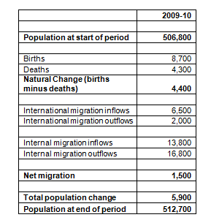
Question 2(b) – 3 marks
Study Fig. 4 in the separate Resource Booklet, a table showing components of population change in Bradford between 2009 and 2010.
Describe the contribution of migration to the total population change in Bradford between 2009 and 2010.
This is an AO4 (skills) question targeting students ability to ‘interpret tables of data’.
There are three marks and so students just need to make three points about the contribution of migration to the total population change in Bradford between 2009 and 2010.
For example, points could include:
  Net migration led to an increase of 1,500 people in Bradford in 2009-10 (✓)
  Most of the increase came from international migration (✓)
  Internal migration saw more people leave than arrive in Bradford (✓)
  The increase due to migration was less than that due to natural change (✓).
Fig. 4 – Components of population change in Bradford between 2009 and 2010

Slide 33
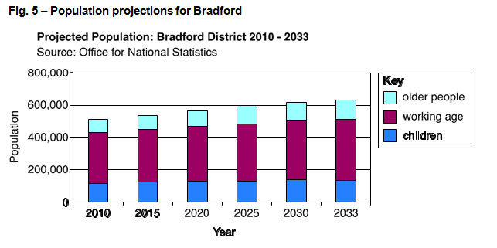
Question 2(c) – 4 marks
Study Fig. 5 in the separate Resource Booklet, a graph showing population projections for Bradford.
Explain the challenges that could be caused by the changing population in Bradford as shown in Fig. 5.
This is an AO3 (application) question as students need to apply their knowledge and understanding to the graph in order to analyse the graph and explain challenges that could be caused by the changing population in Bradford shown.
Example Answer:
The increase in the population of Bradford projected between 2010 and 2033 could cause issues for housing as the extra people will need somewhere to live (✓). A greater number of people living in Bradford will place a lot of pressure upon its infrastructure with transport networks needing to be improved (✓). The rise in the number of older people will cause challenges for healthcare as the elderly visit their doctor more often and have more home visits (✓). A greater number of older people will also mean that leisure activities aimed at older people will need to be expanded (✓).

Slide 34
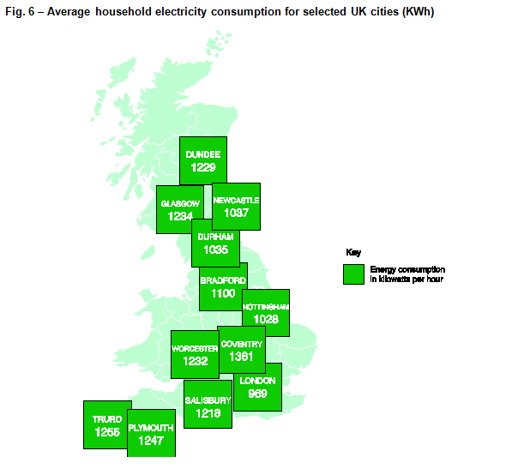
Question 2(d)
Changing populations can affect levels of energy supply and demand.
Study Fig. 6 in the separate Resource Booklet, a map showing the average household electricity consumption for selected UK cities.
Questions will refer to the map in Fig. 6 and could be on any aspect at the moment, students should read the question first so they know what to focus on.

Slide 35
Question 2(d)(i) – 1 mark
Calculate the difference between the average household energy consumption for Bradford and Plymouth.
This is an AO4 (skills) question where students must demonstrate an understanding of numbers.
The difference between the two figures is simply the larger number minus the smaller figure. Therefore 1247 (Plymouth) minus 1100 (Bradford) is ‘147’.
Students do not need to show their working as there is no command to and there is only one mark available.
Remember also that students can use a calculator in the exam if they wish to!

Slide 36
Question 2(d)(ii) – 1 mark
Calculate the range of average electricity consumption for the cities shown in Fig. 6.
This is an AO4 (skills) question where students must show that they understand and correctly use measures of spread, in this instance the range.
The range is the difference between the largest value and the smallest value. Coventry has the largest value at 1361 and London has the smallest value at 969. The answer is ‘392’ (1361 - 969).
Students do not need to show their working as there is no command to and there is only one mark available.
Remember also that students can use a calculator in the exam if they wish to!

Slide 37
Question 2(d)(iii) – 1 mark
Suggest one improvement that could be made to the data presentation technique shown in Fig. 6.
In this question students must show that they can suggest improvements to maps. This is an AO4 (skills) ‘adapt’ question as even though students do not have to physically change the map themselves, they are suggesting how it could be adapted. Questions assessing this part of the assessment objective are required within each set of assessments.
For example, suggestion might include:
  Use of proportional symbols (✓)
  Located bar charts (✓)
  Change of colours (✓)

Slide 38
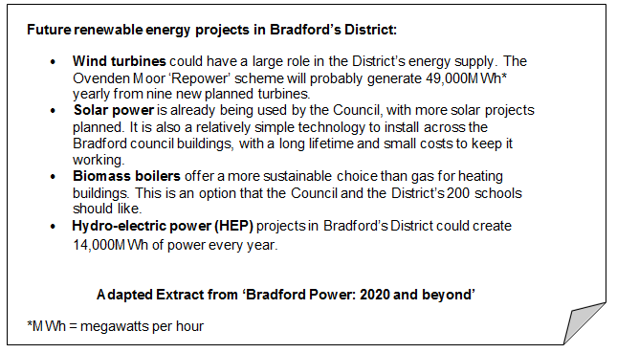
Question 2(e) – 6 marks
Study the extract below.
Assess how population increase in the city of Bradford could affect the demand for renewable energy projects, such as those outlined in the extract.
This question is split evenly between AO2 (understanding) and AO3 (application). This is a synoptic question – drawing together two elements of content from different themes within the specification. In this instance, population increase from People of the UK and renewable energy from UK Environmental Challenges.
Students therefore need to show understanding (AO2) of the concepts of population increase and renewable energy as well as apply this understanding to analyse (AO3) how population increase in the city of Bradford could affect the demand for renewable energy projects. The resources throughout the assessment so far have been building up to provide students with a context of Bradford, its population and now energy projects in Bradford.

Slide 39
Question 2(e) – The mark scheme
Level 3 (5–6 marks)
An answer at this level demonstrates a thorough understanding of the concepts of population increase and renewable energy (AO2) and applies their understanding to give a thorough analysis of how population increase in the city of Bradford could affect the demand for renewable energy projects (AO3).
This will be shown by including well-developed ideas about the concepts of population increase and renewable energy and how population increase in the city of Bradford could affect the demand for renewable energy projects.
There are clear and explicit attempts to make appropriate synoptic links between content from different parts of the course of study.
Level 2 (3–4 marks) looks for the same focus in answers but with reasonable understanding and analysis through developed ideas. There are attempts to make synoptic links between content from different parts of the course of study but these are not always appropriate.
Level 1 (1–2 marks) looks for the same focus in answers but with basic understanding and analysis through simple ideas about the concepts of population increase and renewable energy and/or how population increase in the city of Bradford could affect the demand for renewable energy projects. There are no synoptic links between content from different parts of the course of study.

Slide 40
Question 2(e) – Indicative Content
Students could focus their answers in a number of ways but to reach the higher levels of the mark scheme they must make clear and explicit attempts to make appropriate links between population increase and renewable energy in this context.
For population increase answers may include focus on general population increase or specific elements of the population, for example an ageing population or an increase in the number of young people (number of, not percentage of population).
For the demand for renewable energy projects answers may focus on a number of elements such as an increase due to government policies (national and/or international) and the positives of renewable energy projects as opposed to non-renewable energy projects.
The implications of the population increasing could include an increased demand for homes, school building, technology parks and health centres. Students must then link these to energy. The next slide will show you a ‘well-developed’, ‘developed’ and ‘simple’ idea to see how they progress.

Slide 41
Question 2(d) – Well-developed? Developed? Simple?
Examples of simple ideas:
Population increase means more people in Bradford will be using energy and so more energy will be needed to meet this demand. Renewable energy projects will be under more demand.
Examples of developed ideas:
Population increase means more people will be in Bradford and so more energy will be used. This will increase the demand for energy in general but in particular renewable energy projects could be in more demand as they offer a cleaner and more sustainable solution than non-renewable energy. More projects will be set up in the Bradford area or projects like the ‘Repower’ scheme may grow even more.
Examples of well-developed ideas:
Population increase could increase the demand for renewable energy projects in Bradford. More people means a greater strain on energy resources for services such as homes, schools and businesses across the city and renewable energy projects could be in more demand as they offer a cleaner more sustainable solution than the alternative non-renewable energy. Renewable energy projects could also help meet UK and EU targets for reductions in carbon emissions and the promotion of electricity and heat generation. On the other hand population increase may not affect the demand for renewable energy projects; it may just affect the demand for energy in general, which would be greater.
This slide shows how ideas may progress from simple to developed and then well-developed.

Slide 42
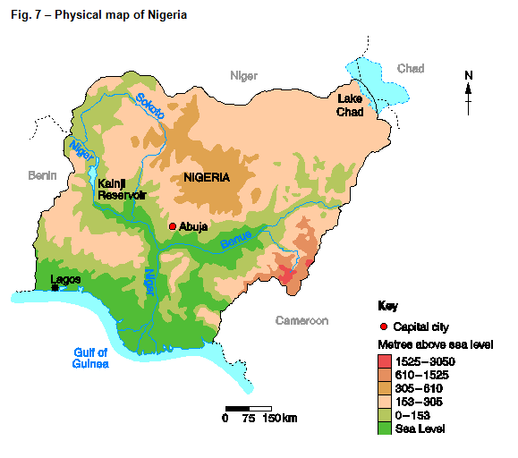
Question 3(a)
Study Fig. 7 in the separate Resource Booklet, a physical map of Nigeria.
Questions will refer to the map in Fig. 7 and could be on any aspect at the moment, students should read the question first so they know what to focus on.

Slide 43
Question 3(a)(i) – 1 mark
Which region of Nigeria contains the most mountainous landscape?
A North
B North East
C South West
D West
This is an AO4 (skills) question where students must use their skill of interpreting maps to decide which of the four options contains the most mountainous landscape. Students might think that the most mountainous landscape is in the East of Nigeria but that isn’t one of the options – so they should remember to always check the four options of an MCQ before focusing on the resource.
The answer is ‘A: North’ as it is the only one of the four options with land higher than 305 metres above sea level.

Slide 44
Question 3(a)(ii) – 1 mark
What style of graph would most clearly show how the relief changes from Abuja to Lake Chad?
A Cross-section
B Horizontal bar
C Radial
D Scatter
This is an AO4 (skills) question where students must select the appropriate graph or chart for the context. This is an example therefore of an AO4 (skills) ‘select’ question, with questions assessing this part of the assessment objective being required within each set of assessments.
The answer is ‘A: Cross-section’ as it is the most appropriate graph to display how relief changes between the two locations.

Slide 45
Question 3(b) – 1 mark
Lagos is the largest city in Africa, with an estimated 21 000 000 people living in the city, whilst the capital city of Nigeria, Abuja, has only 3 000 000 people living there.
What is the ratio 21 000 000:3 000 000 in its simplest form?
The geographical skill (AO4) assessed is the ability to understand and correctly use ratio.
A ratio is a way to compare amounts of something. They can be simplified by finding common factors. The simplest thing to do initially when calculating the ratio of a very large number like this is to remove the 0’s at the end of each number – 21 000 000 and 3 000 000 both have six 0’s and so can automatically become 21:3. Both of these numbers are divisible by 3 and so the ratio in it’s simplest form is 7:1.
Once again, there are no marks for working out as it is not in the question and there is only one mark available. Remember also that students can use calculators in this exam!

Slide 46
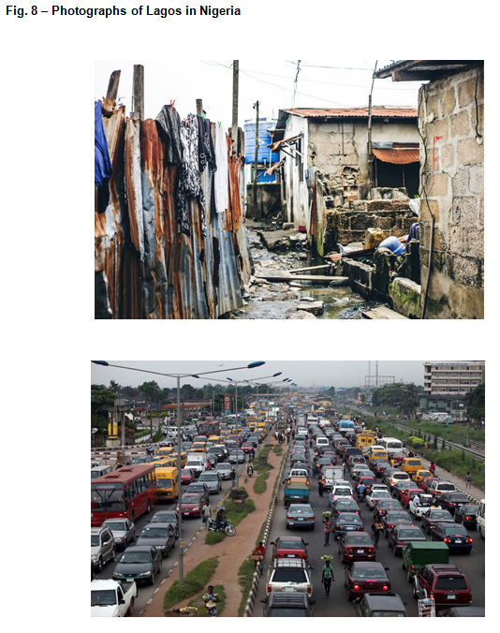
Question 3(c) – 3 marks
Study Fig. 8, the photographs of Lagos in Nigeria.
Using Fig. 8, identify one characteristic from the photographs that shows Lagos is a city in an LIDC.
Give reasons for your answer.
This question has one mark (✓) for identifying one characteristic from the photographs which show Lagos is a city in an LIDC (AO4 – skills – interpreting visual images including photographs). There are then two marks (DEV) for applying knowledge and understanding (AO3) to analyse the photographs and giving reasons which relate the characteristic to cities in LIDCs.
Characteristics identified could include: problems with traffic/congestion (✓), issues with air pollution (✓), poor building quality (✓), lack of sanitation (✓)
For example:
There is a big traffic problem (✓) in one of the photographs which is a characteristic which shows that Lagos is a city in an LIDC. There are lots of cars stretching into the distance which can be an infrastructure issue (DEV) and the traders selling things to people in the traffic shows this is a regular occurrence as they were ready for them (DEV) which is more typical in LIDCs.

Slide 47
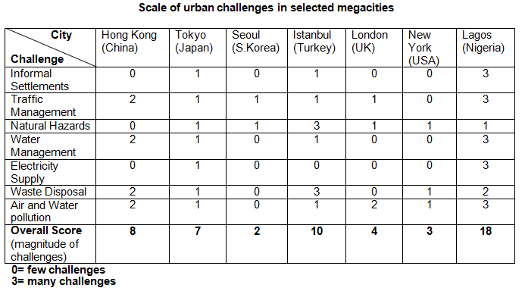
Question 3(d) – 3 mark
Study the table below.
Outline the evidence that suggests Lagos has the most severe urban challenges of the cities shown.
This is an AO3 (application) question where students must apply their knowledge and understanding to interpret the table and outline the evidence that suggests Lagos has the most severe urban challenges of the cities shown.
Any appropriate answer should be rewarded, with examples including:
Highest score in five different categories (✓)
Only two categories with a score of one or below (✓)
Overall score was the highest by eight points (✓)
Greatest number of 3s (✓)

Slide 48
Question 3(e)* – 8 marks
‘Cities in the UK face challenges which are less serious than cities in LIDCs or EDCs.’
To what extent do you agree with this statement?
An 8 mark question which is split between understanding (AO2) and application of knowledge and understand to evaluate and make judgements (AO3). This is a synoptic question – drawing together two elements of content from different themes within the specification. In this instance, UK cities from People of the UK and LIDC or EDC cities from People of the Planet.
This question requires understanding of challenges in cities in the UK and LIDCs or EDCs – but as there are no knowledge marks case study information is not required.
‘To what extent do you agree’ means that an assessment of the degree of agreement based on the evidence in the argument is needed. This will require a judgement as to the amount of agreement as well as an evaluation of whether cities in the UK face challenges which are less serious than cities in LIDCs or EDCs.
The asterisk (*) shows that ‘Quality of extended response’ will be assessed in this question.

Slide 49
Question 3(e)* – The mark scheme
Level 3 (6–8 marks)
An answer at this level demonstrates a thorough understanding of challenges in cities in the UK and LIDCs or EDCs (AO2). There is a thorough evaluation of whether cities in the UK face challenges which are less serious than cities in LIDCs or EDCs with a reasonable judgement as to the extent to which the statement is agreed with (AO3).
This will be shown by including well-developed ideas about the challenges of cities in the UK and LIDCs or EDCs.
There are clear and explicit attempts to make appropriate synoptic links between content from different parts of the course of study.
Level 2 (3–5 marks) looks for the same focuses in answers but with reasonable understanding and evaluation with a basic judgement through developed ideas. There are attempts to make synoptic links between content from different parts of the course of study but these are not always appropriate.
Level 1 (1–2 marks) looks for the same focuses in answers but with basic understanding and evaluation but no judgement through simple ideas. There are no synoptic links between content from different parts of the course of study.
‘Quality of extended response’ is assessed within each level – you can find out more about the Quality of Extended Response descriptors on slide 10.

Slide 50
Question 3(e)* – Indicative Content
Students could focus their answers in a number of ways but to reach the higher levels they must make clear and explicit attempts to make appropriate links between cities in the UK and cities in LIDCs or EDCs.
Challenges of cities in the UK could potentially include:
  affordable
  housing availability
  transport provision
  waste management
  requirement for economic rejuvenation
  loneliness.
Challenges of cities in LIDCs or EDCs could potentially include:
  informal settlements
  traffic congestion
  water management (access to clean water)
  electricity supplies (lack of infrastructure)
  waste disposal and pollution (water and air)
  crime.
However, the challenges students discuss will depend on the examples which were discussed in their learning and so there is great flexibility to allow for students to use different elements which they understand to be challenges within UK and LIDC or EDC cities.

Slide 51
Question 3(e)* – The mark scheme
Example of well-developed ideas:
Cities in the UK and in LIDCs both have challenges surrounding housing, however they are different and it could be argued that LIDC’s face more serious challenges. In LIDCs the challenges of informal settlements result from when large scale economic migration takes place as people move from rural areas in search of work but leads to unplanned, overcrowded and sometimes illegal developments which can lack adequate sanitation or water supply. In the UK the lack of affordable housing provides a challenge for the Government and for residents but not to the same degree as the housing challenges facing cities in LIDCs. However, it can be argued that there is greater community spirit in the LIDC informal settlements than in UK housing estates, and therefore the challenge of building social cohesion is far greater in the UK cities and it has been known for people to pass away in their home and go unnoticed for weeks or months. The challenges in UK cities therefore can’t be directly compared to those in LIDC cities.
This well-developed idea begins with a sentence which integrates understanding with an evaluative comment.
It is then followed by two sentences showing an understanding of the challenges within both LIDC cities and UK cities. There is wording which compares UK cities to LIDC cities as well as judgemental comments on the agreement with the statement.

Slide 52

Question 4(a)
Some Geography students have been conducting human geography fieldwork in Bradford city centre. They intend to investigate urban traffic issues.
The first question of the students’ questionnaire is shown below.
Questions will refer to the questionnaire but the focus is unknown, students should read the question first so they know what to focus on.

Slide 53
Question 4(a)(i) – 2 marks
Suggest two problems with the students’ first question.
2 marks available for applying knowledge and understanding (AO3) of students ‘understanding of the range of techniques and methods used in fieldwork, including observation and different kinds of measurement’ to the questionnaire to suggest two problems with it. This is AO3 (application) ‘evaluation’ as students are appraising the questionnaire in this context.
Any appropriate answer should be credited, with examples including:
Choices do not include units e.g. miles (✓)
Some people may have travelled less than one (mile) or more than six (miles) (✓)
Distances overlap with 2 miles in two boxes and 4 miles in two boxes (✓)

Slide 54
Question 4(a)(ii) – 1 mark
Identify one other question you might want to add to the students’ questionnaire investigating urban traffic issues.
This is a 1 mark question for students adapting (AO4 - skills) the questionnaire by identifying one other question which could be added to the students’ questionnaire investigating urban traffic issues. This is again assessing students ‘understanding of the range of techniques and methods used in fieldwork, including observation and different kinds of measurement’.
Any appropriate question should be credited, with examples including:
How old are you? (✓)
What method of transport do you use to visit the CBD? (✓)
Why do you travel into the CBD? (✓)

Slide 55
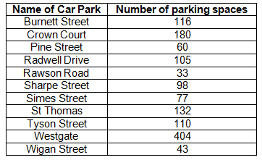
Question 4(b) – 3 marks
As part of the students’ investigation into urban traffic issues they researched the number of car parking spaces in Bradford city centre. The data they collected is in the table below:
Calculate the upper quartile value of the dataset. You must show your working out.
This is a 3 mark question for students ‘analysing and explaining data collected in the field’ by using their skill (AO4) of understanding and correctly using measures of cumulative frequency, including quartiles. There are marks for showing working out on this question and so the following slide will run through the process to getting all three marks.

Slide 56


Question 4(b) – The mark scheme
Calculate the upper quartile value of the dataset. You must show your working out.
There are three marks for this question with one being for the right answer (so even if the student has the right answer but they show no working out they will still get one mark). There is then one mark for ordering the dataset and then the final mark is for showing the working of the upper quartile value.
From the table the dataset should be ordered from lowest to highest.
The upper quartile is the (3 x (n+1)) ÷ 4 th value (where n is the number of values in the dataset).
There are 11 values in the dataset so n = 11.
(3 x (11+1) ÷ 4 = 9th value (DEV) (this is because 3 x 12 is 36 and 36 divided by 4 is 9)
The 9th value is ‘132’ (✓) so that is the answer.

Slide 57
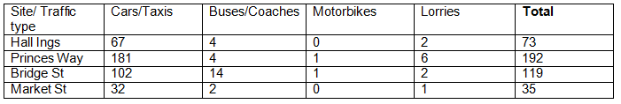
Question 4(c) – 6 marks
Refer back to Fig. 2 in the separate Resource Booklet.
The students conducted a traffic count at a series of 20 sites in the area shown in Fig. 2, GIS maps with information about Bradford.
Traffic was counted for five minutes at each site.
The results for four of the sites are shown in the table below.
Describe one way this data might be presented in a fieldwork investigation and explain why you have selected this data presentation method.
This is a 6 mark question where students must select (AO4 - skills) a way the data might be presented and explain their selection. This is targeting the fieldwork skill of ‘processing and presenting fieldwork data in various ways including maps, graphs and diagrams’.

Slide 58
Question 4(c) – The mark scheme
Level 3 (5–6 marks)
An answer at this level demonstrates a thorough description of the selected suitable choice of data presentation and explanation of why this is a suitable presentation method to investigate the question (AO4).
This will be shown by including well-developed ideas.
Level 2 (3–4 marks) looks for the same focuses in answers but with reasonable description and explanation of selected choice through developed ideas.
Level 1 (1–2 marks) looks for the same focuses in answers but with basic description and explanation of selected choice through simple ideas.

Slide 59
Question 4(c) – Well-developed? Developed? Simple?
A wide range of presentation techniques should be expected and those selected are likely to come from the list of cartographic and graphical skills set out in the specification. Examples might include bar graphs, proportional pie charts, line graphs, located graphs – but any effective technique of presentation which helps to interpret the data would be acceptable.
Credit will be gained by the quality of the explanation offered, the support provided in evidence.
The examples below show what might be considered ‘well-developed’, ‘developed’ and ‘simple’ ideas and how an answer might progress from one to the other.
Examples of well-developed ideas:
Students could draw located bar charts on a base map of Bradford city centre, with a key to represent the scale and type of traffic. This would help to visualise the findings as you would be able to see the location of a particular set of data and relate it to the characteristics of the area in question.
Examples of developed ideas:
Students could draw located bar charts which display the information on the table in a series of bar charts on a base map. This would be good as you could see where the different traffic levels were for the different types of traffic.
Examples of simple ideas:
Students could draw bar charts to show how much traffic there was at each location. This would let you compare the types of traffic.

Slide 60
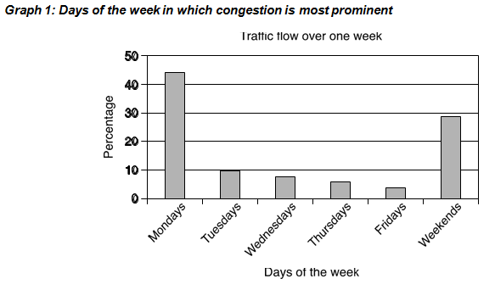
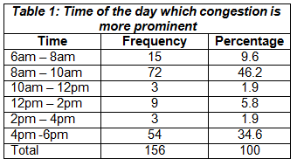
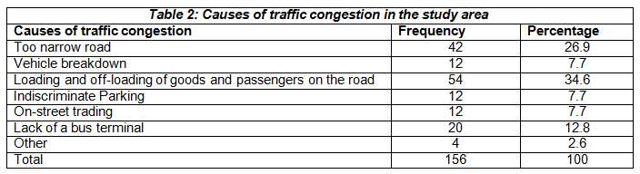
Question 4(d*) – 8 marks (+3 SPaG)
Study the tables and graphs below which display the results of their questionnaire asked to local residents.
Suggest a conclusion that the students’ might reach for the enquiry question ‘How do patterns of congestion vary in Bradford?’. Analyse the evidence from the information provided to explain how you have reached that conclusion.

Slide 61
Question 4(d*) – 8 marks (+3 SPaG)
Suggest a conclusion that the students’ might reach for the enquiry question ‘How do patterns of congestion vary in Bradford?’. Analyse the evidence from the information provided to explain how you have reached that conclusion.
An 8 mark question which is all AO3 (application) – remember fieldwork questions cannot have any marks for AO1 or AO2 due to the Assessment Objective weightings set by Ofqual (see slide 13).
The question requires students to apply their knowledge and understanding of their fieldwork skill of ‘drawing evidenced conclusions and summaries from fieldwork transcripts and data’ to the unseen resources of Tables 1 and 2 and Graph 1. There are equal marks attributed to the analysis of the information in these resources and also for coming to a conclusion which answers the question.
The asterisk (*) shows that ‘Quality of extended response’ will be assessed in this question – see slide 10 for more information on the ‘Quality of extended response descriptors’.
There are marks for SPaG (Spelling, punctuation and grammar and the use of specialist terminology) you can find out more about the SPaG descriptors on slide 9.

Slide 62
Question 4(d*) – The mark scheme
Level 3 (6–8 marks)
The answer must include a thorough analysis (AO3) of the data provided with justification from all sources of information which is linked together to reach a thorough conclusion (AO3).
This will be shown by including well-developed ideas.
Level 2 (3–5 marks) looks for the same focuses in answers but with reasonable analysis and conclusions through developed ideas.
Level 1 (1–2 marks) looks for the same focuses in answers but with basic analysis and evaluation through simple ideas.
‘Quality of extended response’ is assessed within each level – you can find out more about the Quality of Extended Response descriptors on slide 10.

Slide 63
Question 4(d*) – Well-developed? Developed? Simple?
Examples of simple ideas:
I think that congestion is a big problem on Mondays and Fridays as this is what most people in the survey said.
Examples of developed ideas:
The data suggests that people thought congestion was a bigger problem on Mondays and at the weekend. This supports the view that congestion is worst on certain days of the week.
Examples of well-developed ideas:
The data suggests that traffic congestion was thought to be a problem every day with 73% of people suggesting this. However another question suggests that it is a particular problem on Mondays and weekends (44% and 28%) which leads me to the conclusion that congestion is a particular problem on certain days of the week.
The examples show what might be considered ‘well-developed’, ‘developed’ and ‘simple’ ideas and how an answer might progress from one to the other.
There should be a conclusion based on the analysis off evidence from the information proved – statistics from the information should be used as evidence. There should be a justification of the conclusion through the analysed evidence.

Slide 64
Question 5(a) – 4 marks
You will have taken part in fieldwork in a physical geography environment as part of your studies. Examples might include a river or a coastal area.
State your fieldwork question for investigation:
Location of study area:
Explain the suitability of one key question or hypothesis that you chose to help answer your fieldwork question for investigation.
Key question/hypothesis:
This is an AO3 (application) question as students need to apply their knowledge and understanding to their own experience of fieldwork of ‘processing and presenting fieldwork data in various ways including maps, graphs and diagrams’ in order to explain the suitability of one key question or hypothesis that you chose to help answer your fieldwork question for investigation.
There is space provided for students to write their fieldwork question for investigation (the overall title) and location of study to help draw their focus.
We have used both terms ‘key question’ and ‘hypothesis’ so that students are clear that they can use either depending on what they used during their fieldwork experiences.

Slide 65
Question 5(a) – The mark scheme
Explain the suitability of one key question or hypothesis that you chose to help answer your fieldwork question for investigation.
Key question/hypothesis:
The four marks are for a justification of why the key question or hypothesis was suitable. There are no marks for stating the key question/hypothesis and so if a student does not write their key question or hypothesis in the space provided it does not affect their mark.
An exemplar answer is given below:
Key Question ‘The River Ouse widens from source to mouth’.
This is a suitable key question as processes such as corrosion and hydraulic action cause erosion of the river banks which widens the river (✓) and leads to an increase in velocity from source to mouth (✓) causing greater erosion. This will help me answer the overall question of whether the River Ouse follows the Bradshaw Model (✓) by investigating one of the characteristics of a how a river varies between the upper course and lower course of a river (✓).

Slide 66
Question 5(b) – 6 marks
Evaluate to what extent one method you used to collect your primary fieldwork data was a success.
This is a 6 mark AO3 (application) question as students need to apply their knowledge and understanding of their own experience of fieldwork to ‘reflect critically on fieldwork data, methods used, conclusions drawn and knowledge gained’ in order to evaluate to what extent one method used to collect primary fieldwork data was success. There are therefore AO3 (application) ‘evaluation’ and ‘judgement’ (for the to what extent part of the question) marks.
Level 3 (5–6 marks)
An answer at this level demonstrates a thorough evaluation of a suitable primary data collection method (AO3) with a reasonable judgement as to its success a method of primary data collection (AO3).
This will be shown by including well-developed ideas.
Level 2 (3–4 marks) looks for the same focuses in answers but with reasonable evaluation and basic judgement through developed ideas.
Level 1 (1–2 marks) looks for the same focuses in answers but with basic evaluation and judgement through simple ideas.

Slide 67
Question 4(c) – Well-developed? Developed? Simple?
Examples of simple ideas:
We floated an orange down the river and timed how long it took. This worked well as we could work out the rivers’ speed which helped us answer our enquiry question.
Examples of developed ideas:
We measured the velocity of the river; we did this five times and took a mean at each location to increase the accuracy of the results. This was an effective method as I was able to compare the velocity at different points along the river which helped answer the overall question. However at times the float used to measure velocity got caught in the stones in the river bed, and this would have affected the final mean which made the results worse.
Examples of well-developed ideas:
We measured the velocity of the river at different locations along the river course; we did this five times and took a mean at each location which increased the accuracy of the results, this was important to produce more secure analysis and conclusions. However a limitation is that at times the float used to measure velocity got caught in the stones in the river bed, this meant that human intervention was required and would have affected the final mean. This was an effective method as I was able to compare the velocity at different points along the river which helped my understanding of how the river changes from source to mouth and this helped us to answer our key enquiry questions.
The evaluation of the success of the selected data collection method could include both positive and negative reflections of the method, allowing the student to make a judgement of its success.
The examples show a potential ‘simple’, ‘developed’ and ‘well-developed’ example and how an answer may progress from one to the other.

Slide 68
We’d like to know your view on the resources we produce. By clicking on ‘Like’ or ‘Dislike’ you can help us to ensure that our resources work for you. When the email template pops up please add additional comments if you wish and then just click ‘Send’. Thank you.
Whether you already offer OCR qualifications, are new to OCR, or are considering switching from your current provider/awarding organisation, you can request more information by completing the Expression of Interest form which can be found here: www.ocr.org.uk/expression-of-interest
Looking for a resource? There is now a quick and easy search tool to help find free resources for your qualification:
www.ocr.org.uk/i-want-to/find-resources/
OCR Resources: the small print
OCR’s resources are provided to support the delivery of OCR qualifications, but in no way constitute an endorsed teaching method that is required by the Board, and the decision to use them lies with the individual teacher. Whilst every effort is made to ensure the accuracy of the content, OCR cannot be held responsible for any errors or omissions within these resources.
© OCR 2017 - This resource may be freely copied and distributed, as long as the OCR logo and this message remain intact and OCR is acknowledged as the originator of this work.
OCR acknowledges the use of the following content: n/a
Please get in touch if you want to discuss the accessibility of resources we offer to support delivery of our qualifications: resources.feedback@ocr.org.uk

