Slide 1
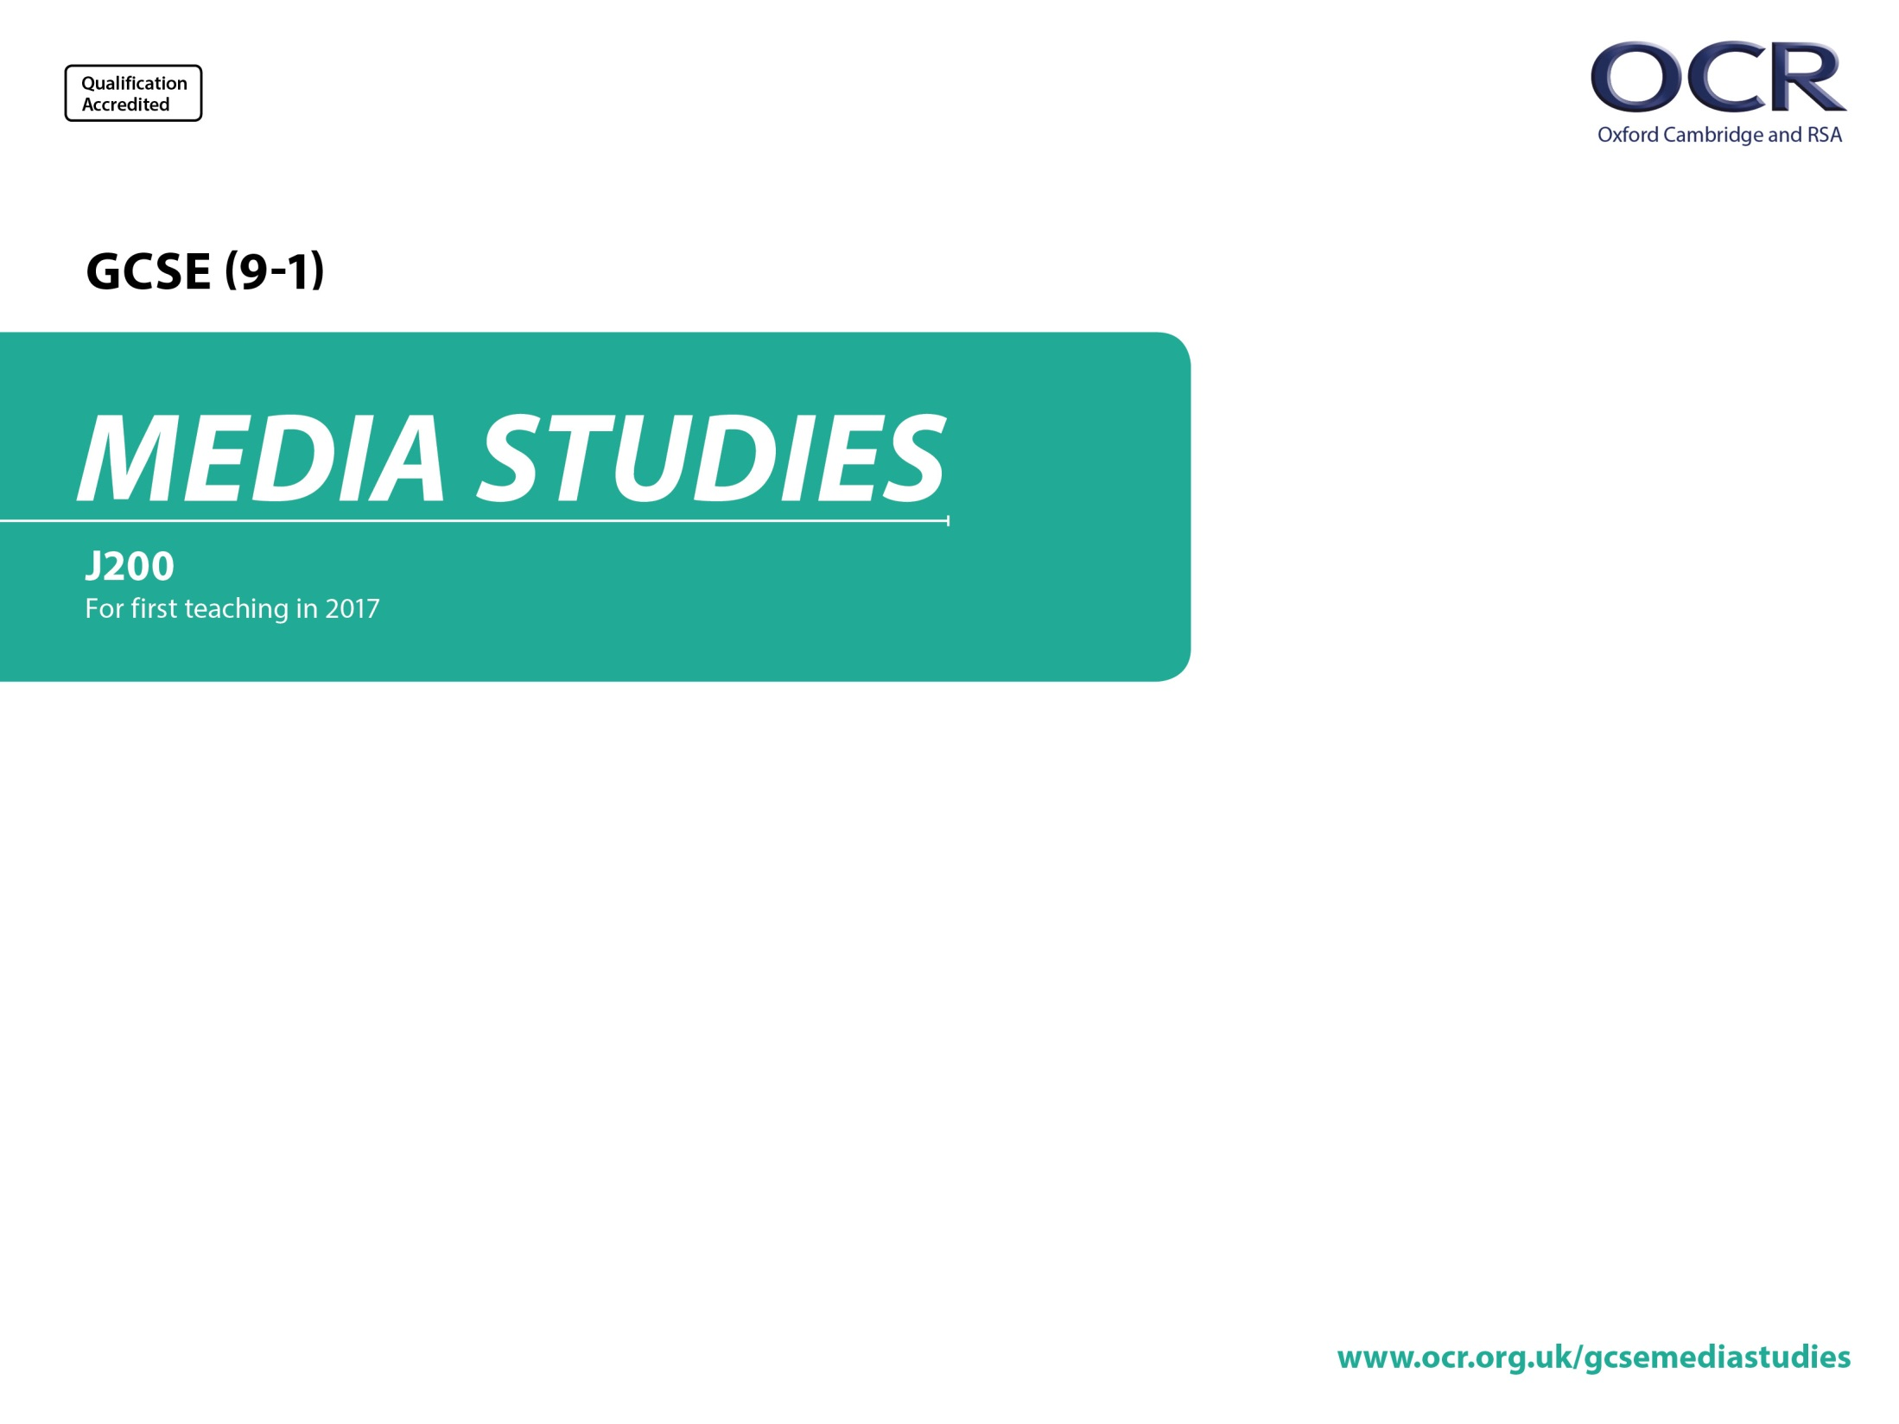
J200/02
Music and News
Annotated Sample Assessment Materials

Slide 2
Guidance
This guide is designed to take you though the GCSE (9-1) Media Studies J200/02 exam paper. Its aim is to explain how candidates should approach each paper and how marks are awarded to the different questions.
The orange text boxes offer further explanation on the questions on the exam
paper. They offer guidance on the wording of questions and what candidates
should do in response to them.
The green text boxes focus on the awarding of marks for each question. They give
further information on the percentage of each assessment objective attributed
to each question. The percentage given is over the whole qualification.
This will always be a comparison of two primary sources requiring evaluation of the sources in their historical context.
AO3 (5%)
Percentage is out of 200 marks for full specification

Slide 3
Assessment Objectives
AOs are useful for teachers to know to understand the assessments but students don’t need to know these.
The wording of the questions will direct students on what kind of response is required e.g. AO1 or AO2.
Theoretical framework of media is the DfE’s name for the four key concepts:
Media Language
Media Representation
Media Industries
Media Audiences
Students will need to know this term for the synoptic question on each paper.
AO1 questions are about the media form in general e.g. radio, video games etc and will usually ask students to refer to the set product to provide examples.
AO1 knowledge and understanding of:
  1. the theoretical framework of media
  2. contexts of media and their INFLUENCE on media products and processes.
AO2 apply the framework to:
  1. ANALYSE MEDIA PRODUCTS using the theoretical framework of media, including in relation to their contexts
  2. make judgements and draw conclusions.
Important interpretation note:
The Ofqual Assessment Objective (AO) AO2.1 is about ANALYSING MEDIA PRODUCTS
Industry and Audience factors are not seen as qualities of a media product. They are external to a media product and therefore cannot be analysed under the wording provided for AO2.1.
Analysis will be of media language and/or representation.
Industry and Audience will be tested under AO1.
Media Language and Representations can be tested under either AO1 or AO2.
Timings
There are 75 minutes of assessment time after the extract has played and 70 marks on the paper.
Students should be instructed to spend approximately a mark a minute on each question, e.g.
1 mark = 1 minute of writing time
4 marks = 4 minutes of writing time
5 marks = 5 minutes writing time
10 marks = 10 minutes writing time
15 marks = 15 minutes writing time

Slide 4
INSERT
We can’t re-produce the images in this document but you can find the extracts for use with this paper through the link below:
http://www.ocr.org.uk/Images/385190-unit-j200-02-music-and-news-insert-sample-assessment-material.pdf

Slide 5
Section A: Music
This is a straightforward knowledge only question (recall) for 1 mark.
These questions are likely to be industry or audience based.
Answer all the questions.
Identify the regulator for radio in the UK. [1]
Explain one way in which music videos use media language to differ from each other. Refer to one example of contrasting media language in two music videos you have studied to support your answer. [4]
Explain how and why producers of radio programmes target different audiences. Refer to the Radio 1 Live Lounge to support your answer. [10]
Refer to Extract 1 in the Insert. Analyse the representation of musicians in Extract 1, which is from MOJO Magazine. [5]
Refer to Extracts 1 and 2 in the Insert.
How far is media language used differently in Extracts 1 and 2 to reflect genre conventions? In your answer you must:
  analyse examples of how media language is used similarly and differently in Extracts 1 and 2, which are from We Love Pop and MOJO magazines
  make judgements and reach conclusions about whether there are more similarities due to genre conventions than differences in the extracts. [15]
AO1.1a (0.5%)
In the live examination the list of set music videos would be reproduced so students don’t have to remember their names.
Note – this is an AO1 knowledge and understanding (K&U) question of music videos.
Students will have analysed the videos in the classroom but in this question they’ll be bringing their K&U of music videos as a form informed by their classroom study of the set videos.
There could be an AO2.1 question asking students to analyse a music video and / or compare music videos. There will be no stimulus provided for music video analysis questions so analysis would be via recall.
AO1.1 (2%)
AO1.1 (5%)
This is an AO1 question on Radio as a media form as a whole. Note the command word ‘explain’ (not ‘analyse’).
In AO1 questions there is usually an instruction to ‘refer to the set product to support your answer’.
The terms ‘how’ and ‘why’ have been used so more than just recall knowledge can be demonstrated and students can also demonstrate their understanding.
AO2.1 (2.5%)
This is an AO2.1 question on music magazines.
It focuses on analysis of an unseen extract, using representation as the focus of analysis from the theoretical framework.
Remember industry and audiences are not qualities of a media product and cannot be analysed using the wording formulation of AO2.1
Q5 is an AO2.1 analysis question that also requires judgements and conclusions (AO2.2)
Exam boards are required to have a question that compares the use of media language in media products. This question fulfils that requirement.
AO2.1 (5%)
AO2.2 (2.5%)
Bullet points are used to provide clarity to students so they know exactly what they need to include in their answers .
Students needn’t answer each bullet point separately. Less able students might structure their answers in that way, whereas more able students might weave analysis and judgements and conclusions together.

Slide 6
Section B: News
This is a straightforward knowledge only question (recall) for 1 mark (AO1.1a).
These questions are likely to be industry or audience based.
Answer all the questions.
Identify one press regulator in the UK. [1]
Explain two ways that newspapers are funded. [4]
Refer to Extract 3 in the Insert. Analyse the use of media language to create meaning in the online Observer home page. Give two examples from Extract 3. [5]
AO1.1a (0.5%)
AO1.1 (2%)
Q7 moves beyond Q6 as it asks for two explanations.
For each explanation a straightforward recall statement (AO1.1a) would score 1 mark; a statement developed with some understanding would score 2 marks (AO1.1 a&b) (see mark scheme in specimen paper for details).
Students should also be guided by the number of marks and lines on the question paper as to how much to write.
AO2.1 (2.5%)
Q8 is an AO2.1 analysis question focussed on the online Observer homepage. Media language is broadly referenced in this question as the element targeted from the subject content.
As stated in the specimen mark scheme, excellent responses in the top mark band ‘will typically explore how meaning is created, including connotative effect(s), by at least two well-chosen examples described accurately using Media Studies terminology’.

Slide 7
Section B: News
Answer all the questions.
Refer to Extract 3 in the Insert. Analyse the use of media language to create meaning in the online Observer home page. Give two examples from Extract 3. [5]
  In this question you will be rewarded for drawing together elements from your full course of study, including different areas of the theoretical framework and media contexts.
  ‘The representations featured in the online Observer reflect its values and beliefs.’ Discuss how far you agree with this statement in relation to Extract 3, the online Observer homepage.
  In your answer you must:
    analyse the representations featured in Extract 3 with reference to the online Observer’s values and beliefs
    make judgements and draw conclusions about how far you agree with the statement.
    In your answer you must also refer to relevant media contexts. [15]
  Explain how broadsheet newspapers reflect the time and historical contexts in which they were published. Refer to the Observer front page from 6 November 1966 that you have studied to support your answer.
  In your answer you must also refer to relevant media contexts. [10]
Question 9 is a synoptic question.
The form of words above the question will be indicated on synoptic questions.
Students who are synoptic (e.g. respond on more than just one area of the framework in their answer, e.g. representation, language and audiences) can access the full mark scheme.
A strong answer focussing only on media representations in this case would be capped halfway up the top level (8/10 marks for AO2.1) – so any penalty is only likely to affect higher ability students.
* Indicates extended response.
*
AO2.1 (5%)
AO2.2 (2.5%)
Q10 is an AO1.2 question (K&U of contexts of media and their influence on media products)
Students can refer to a variety of historical contexts e.g. historical social, historical cultural, historical political etc. (see mark scheme indicative content for exemplification).
As the question refers to contexts as a plural a strong answer would be expected to focus on more than one context.
Remember AO1 questions are about the media form so students can talk broadly about newspapers and exemplify using the Observer. See indicative content in SAMs for exemplification.
AO1.2 (5%)

