Slide 1
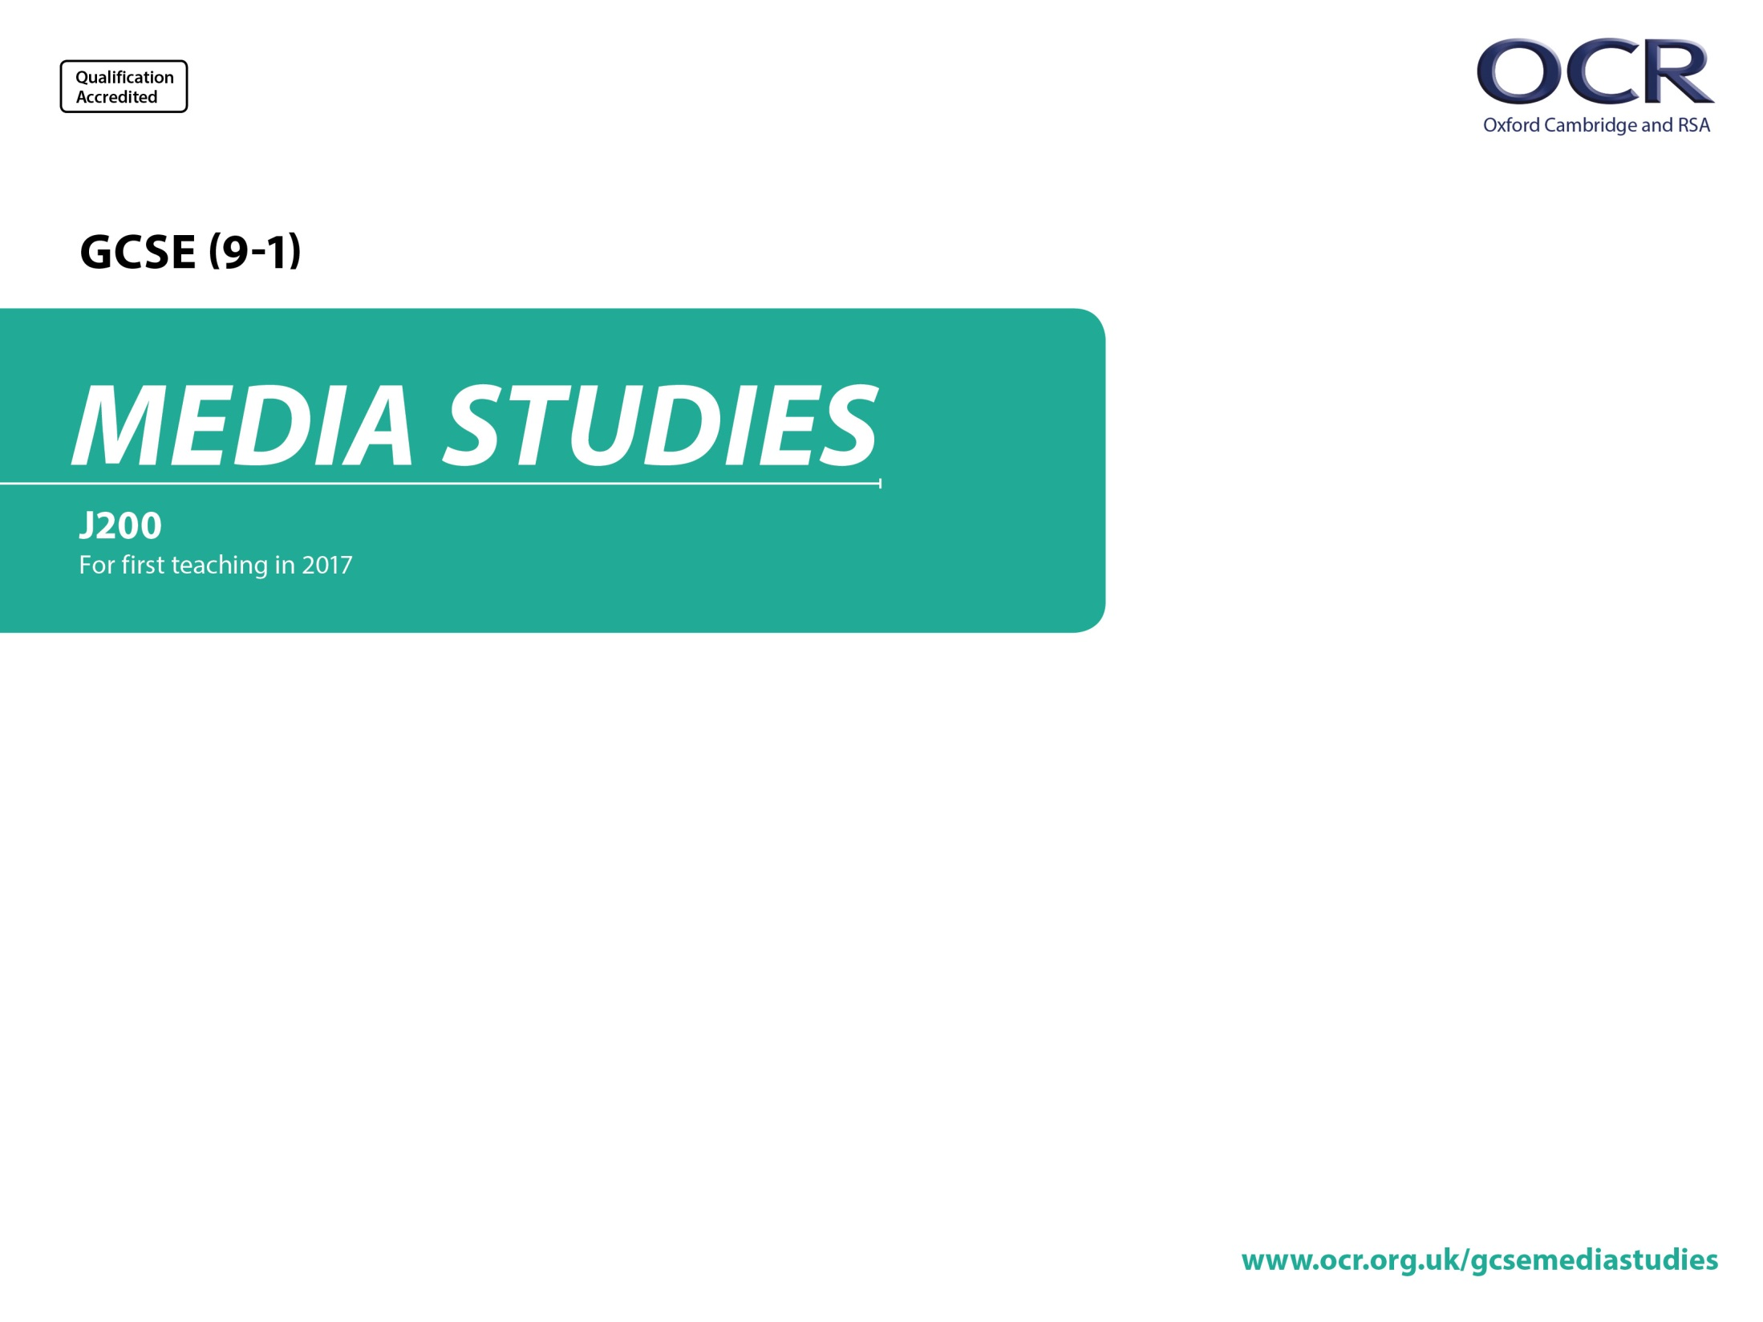
J200/01
Television and Promoting Media
Annotated Sample Assessment Materials

Slide 2
Guidance
This guide is designed to take you though the GCSE (9-1) Media Studies J200/01 exam paper. Its aim is to explain how candidates should approach each paper and how marks are awarded to the different questions.
The orange text boxes offer further explanation on the questions on the exam
paper. They offer guidance on the wording of questions and what candidates
should do in response to them.
The green text boxes focus on the awarding of marks for each question. They give
further information on the percentage of each assessment objective attributed
to each question. The percentage given is over the whole qualification.
This will always be a comparison of two primary sources requiring evaluation of the sources in their historical context [this is an example].
AO3 (5%)
Percentage is out of 200 marks for full specification

Slide 3
Assessment Objectives
AOs are useful for teachers to know to understand the assessments but students don’t need to know these.
The wording of the questions will direct students on what kind of response is required e.g. AO1 or AO2.
Theoretical framework of media is the DfE’s name for the four key concepts:
Media Language
Media Representation
Media Industries
Media Audiences
Students will need to know this term for the synoptic question on each paper.
AO1 questions are about the media form in general e.g. radio, video games etc and will usually ask students to refer to the set product to provide examples.
AO1 knowledge and understanding of:
  1. the theoretical framework of media
  2. contexts of media and their INFLUENCE on media products and processes.
AO2 apply the framework to:
  1. ANALYSE MEDIA PRODUCTS using the theoretical framework of media, including in relation to their contexts
  2. make judgements and draw conclusions.
Important interpretation note:
The Ofqual Assessment Objective (AO) AO2.1 is about ANALYSING MEDIA PRODUCTS.
Industry and Audience factors are not seen as qualities of a media product. They are external to a media product and therefore cannot be analysed under the wording provided for AO2.1.
Analysis will be of media language and/or representation
Industry and Audience will be tested under AO1.
Media Language and Representations can be tested under either AO1 or AO2.
Timings
There are 75 minutes of assessment time after the extract has played and 70 marks on the paper.
Students should be instructed to spend approximately a mark a minute on each question, e.g.
1 mark = 1 minute of writing time
4 marks = 4 minutes of writing time
5 marks = 5 minutes writing time
10 marks = 10 minutes writing time
15 marks = 15 minutes writing time

Slide 4
Section A: Television
Section A
Questions 1 to 3 will based upon the unknown extract played in the examination (a sequence from the set episode of Cuffs or The Avengers).
Questions 1 to 3 are likely to be based upon media language and/or representation
Questions 4 and 5 won’t be based upon the extract.
These questions are likely to be industry and/or audience and/or context questions.
At least one of Q4 or Q5 is likely to be based upon the set television drama not used in the extract (in this example Q5 is on The Avengers whereas the extract is from Cuffs).
Question 1 is a 5 mark media language analysis question. Students need to reference two examples from the extract in relation to how the set element of media language has been used to create meaning.
In this case the element is sound.
In this type of question the media language element could also be camerawork, mise-en-scène or editing.
AO2.1 (2.5%)
‘Analyse how sound is used in the extract to create meaning. Refer to at least two examples from the extract in your answer. [5]
Analyse how far the extract depicts the police’s point of view rather than the criminals’ point of view. In your answer you must:
  analyse aspects of the extract using examples to support your analysis
  judge how far these aspects depict the police’s point of view. [10]
In this question you will be rewarded for drawing together elements from your full course of study, including different areas of the theoretical framework and media contexts.
How far does the extract try to create a sense that it is portraying 'real life'?
In your answer you must:
  analyse aspects of the extract giving detailed examples
  judge how far these aspects create a sense of watching 'real life'. [15]
Describe what is meant by 'Public Service Broadcasting' (PSB). Use the BBC as an example in your answer. [5]
The Avengers
Explain how social contexts influence television programmes. Refer to The Avengers from 1965 to support your answer. [10]
Answer all the questions.
AO2.1 (2.5%)
AO2.2 (2.5%)
Bullet points are used to provide clarity to students so they know exactly what they need to include in their answers.
Students needn’t answer each bullet point separately. Less able students might structure their answers in that way, whereas more able students might weave analysis and judgements and conclusions together.
*
Q4 in the SAM is an AO1 knowledge and understanding question (no requirement for analysis).
The questions is about the media form (television). This question is targeting an element of the media industries subject content on PSB. Students are asked to refer to the BBC in their answer as they will have studied PSB industry factors in relation to Cuffs.
Students don’t need to mention the set product unless instructed.
Here they can broadly reference the BBC.
AO2.1 (5%)
Question 3 is a synoptic question.
The form of words above the question will be indicated on synoptic questions.
Students who are synoptic (e.g. respond on more than just one area of study in their answer, e.g. representation, contexts, audiences) can access the full mark scheme.
A strong answer focussing only on media language in this case would be capped halfway up the top level (8/10 marks for AO2.1) – so any penalty is only like to affect higher ability students.
* Indicated extended response.
AO2.2 (2.5%)
AO1.1 (2.5%)
Q5 in the SAM is an AO1 contexts question (no requirement for analysis).
The questions is about how social contexts influence television programmes generally – but note here students are required to reference The Avengers to support their answer.
AO1.2 (5%)

Slide 5
Section B: Promoting Media
This is a straightforward knowledge only question (recall) for 1 mark (AO1.1a).
These questions are likely to be industry or audience based.
Identify the organisation that 'age rates' video games in the UK. [1]
Explain two reasons why a film company would release a video game linked to a film. [4]
Explain at least two uses and gratifications of video games using Blumler and Katz's theory. Refer to The Lego Movie Video Game to support your answer. [10]
Analyse how genre codes have been used in The Lego Movie poster campaign to appeal to a family audience.
In your answer you must also refer to relevant media contexts. [10]
NB - Due to copyright, we are unable to provide the images of the poster campaign here. However, the list below contains details of the images.
1 The main poster featuring an ensemble cast, running from danger (http://www.impawards.com/2014/lego_movie_ver9.html)
2 Character poster of Vitruvius in close-up (http://www.impawards.com/2014/lego_movie_ver3.html)
3 Character poster of Emmet in close-up (http://www.impawards.com/2014/lego_movie_ver8.html)
4 Character poster of Lord Business in close-up (http://www.impawards.com/2014/lego_movie_ver5.html)
5 Character poster of Wyldstyle in close-up (http://www.impawards.com/2014/lego_movie_ver7.html)
Answer all the questions.
AO1.1a (0.5%)
Q7 question moves beyond Q6 as it asks for two reasons/examples.
For each example a straightforward recall statement (AO1.1a) would score 1 mark, a statement developed with some understanding would score 2 marks (AO1.1 a&b) (see mark scheme in specimen paper for details).
AO1.1 (2%)
AO1.1 (5%)
Q8 asks about one of the set theoretical perspectives. In this case Blumer and Katz’s Uses and Gratifications. Whenever one of the set theoretical perspectives is required it will be directly referenced in the question for clarity.
Remember the AOs – because this is an audience question (audience is not a property of a media product - it is external to the product) it is not an analysis question. It is a K&U question.
AO2.1 (5%)
Q9 is an analysis (AO2.1) question on advertising and marketing. In this case The Lego Movie set posters.
In the live examination the images would be reproduced in print. For copyright reasons links are provided here.
Note, in this question students are also given the instruction to refer to media contexts in their analysis – which is also part of AO2.1. When contexts are required they will always be explicitly asked for.

